Slide 1

Database Processing: Fundamentals, Design, and Implementation
15th Edition
Week #1
Introduction

Slide 2
How Did We Get Here? The Internet World I
Personal Computers
1977: Apple II
1981: IBM PC
Local Area Networks
Ethernet networking technology
Early 1970s: Xerox Palo Alto Research Center
1983: U.S. National Standard

Slide 3
How Did We Get Here? The Internet World II
The Internet
1969: ARPANET
World Wide Web (WWW)
1993: First Web browser (Netscape) available
Mid 1990s: Online retail sites
1995: Amazon
Followed by Best Buy
Early 2000s: Web 2.0

Slide 4
How Did We Get Here? The Smartphone World
Mid 1970s: Mobile Phone (Cell Phone)
Smartphone
2007: Apple iPhone
2008: Google Android Operating System
Tablets
2010: Apple iPad
Apps
All of these examples depend on databases

Slide 5
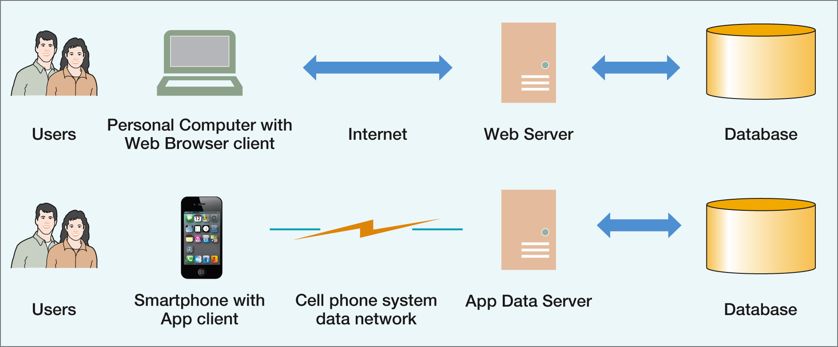
The Internet and Mobile Device World

Slide 6
Databases in the Internet and Mobile Device World
Databases are important because they are everywhere and are used daily:
Facebook
Twitter
Online shopping

Slide 7
The Characteristics of Databases
The purpose of a database is to help people track things of interest to them.
Data is stored in tables, which have rows and columns like a spreadsheet.
A database may have multiple tables, where each table stores data about a different thing.
Each row in a table stores data about an occurrence or instance of the thing of interest.
A database stores data and relationships.

Slide 8
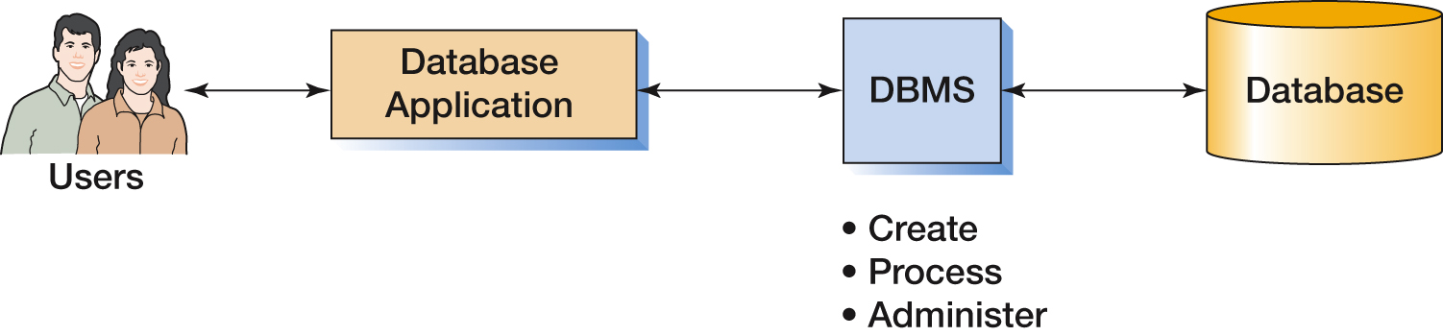
The Components of a Database System

Slide 9
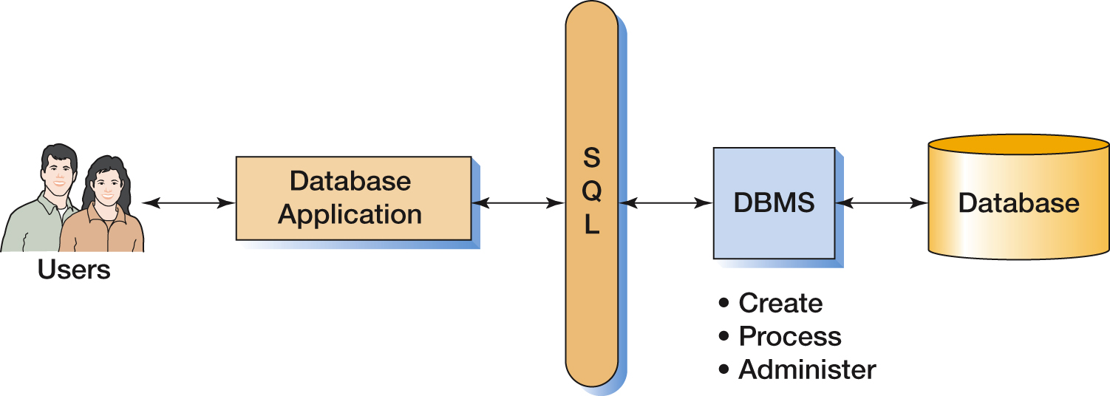
The Components of a Database System with SQL

Slide 10
Applications, the DBMS, and SQL
Applications are the computer programs that users work with.
The Database Management System (DBMS) creates, processes, and administers databases.
Structured Query Language (SQL) is an internationally recognized standard database language that is used by all commercial DBMSs.

Slide 11
Functions of a DBMS
Functions of a DBMS
Create database
Create tables
Create supporting structures (e.g., Indexes)
Modify (insert, update, or delete) database data
Read database data
Maintain database structures
Enforce rules
Control concurrency
Perform backup and recovery

Slide 12
The Database
A database is a self-describing collection of integrated tables.
The tables are called integrated because they store data about the relationships between rows of data.
A database is called self-describing because it stores a description of itself.
The self-describing data is called metadata, which is data about data.

Slide 13
Typical Metadata Tables (1 of 2)
TableName | NumberColumns | PrimaryKey
STUDENT | 4 | StudentNumber
CLASS | 4 | ClassNumber
GRADE | 3 | (StudentNumber, ClassNumber)

Slide 14
Typical Metadata Tables (2 of 2)
ColumnName | TableName | DataType | Length (bytes)
StudentNumber | STUDENT | Integer | 4
LastName | STUDENT | Text | 25
FirstName | STUDENT | Text | 25
EmailAddress | STUDENT | Text | 100
ClassNumber | CLASS | Integer | 4
Name | CLASS | Text | 25
Term | CLASS | Text | 12
Section | CLASS | Integer | 4
StudentNumber | GRADE | Integer | 4
ClassNumber | GRADE | Integer | 4
Grade | GRADE | Decimal | (2,1)

Slide 15
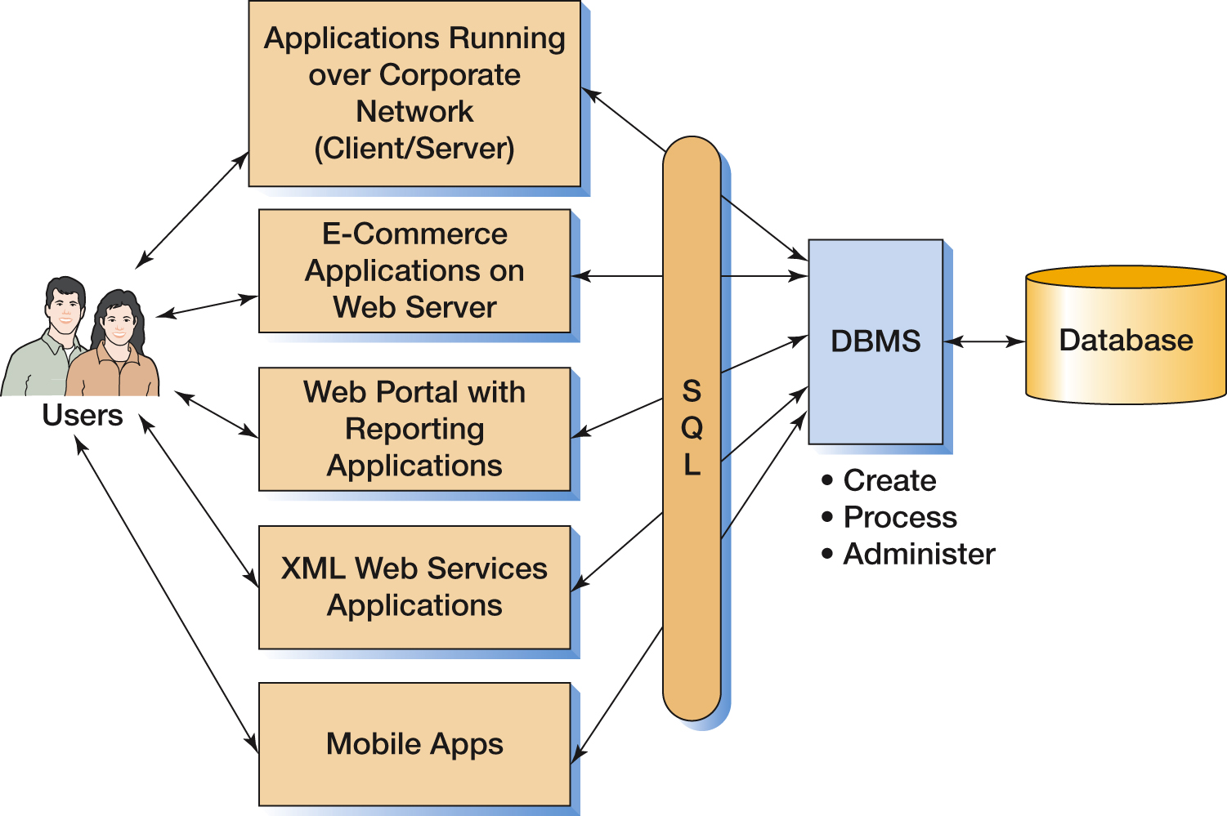
Components of an Enterprise-Class Database System

Slide 16
Three Types of Database Design
Types of Database Design Process
From existing data
Analyze spreadsheets and other data tables
Extract data from other databases
Design using normalization principles
New systems development
Crete data model from application requirements
Transform data model into database design
Database redesign
Migrate databases to newer databases
Integrate two or more databases
Reverse-engineer and design new database using normalization principles and data model transformation

Slide 17
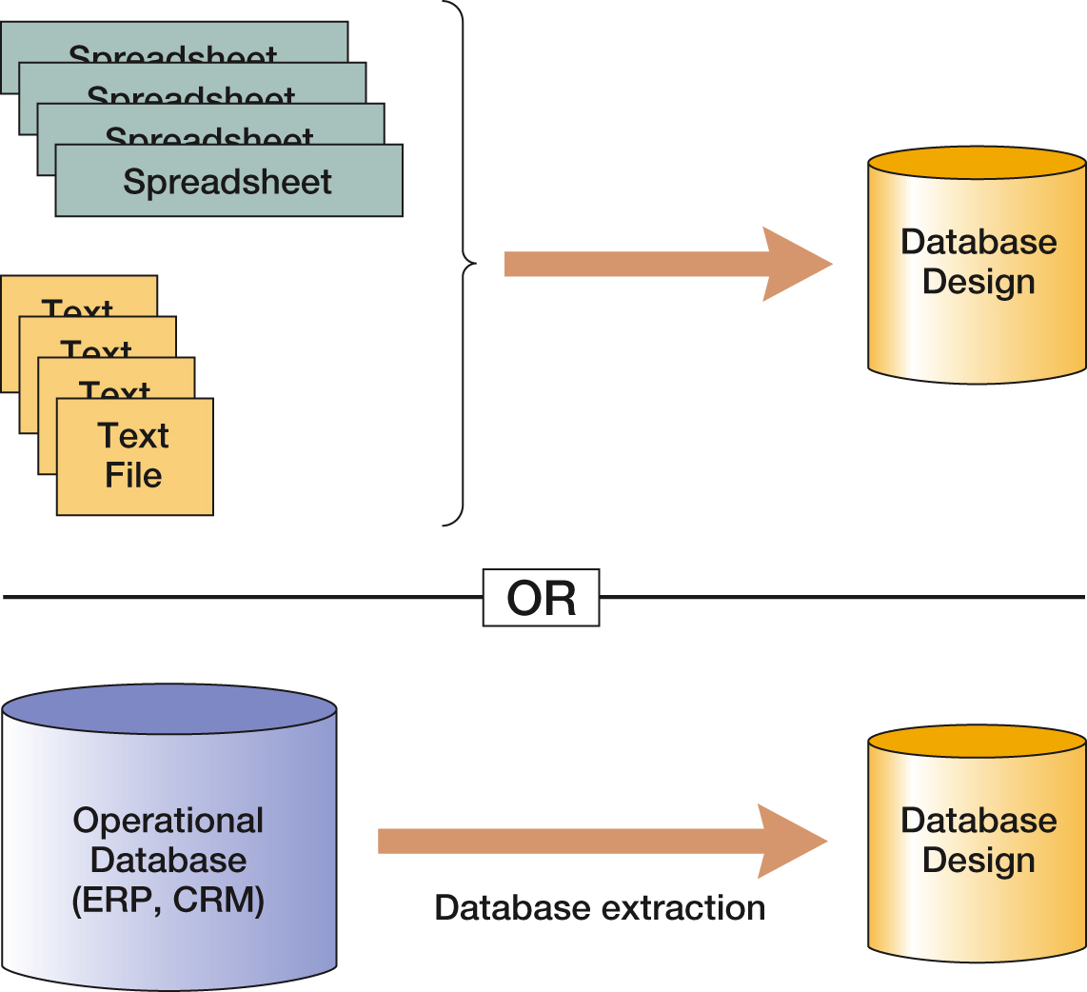
Databases Originating from Existing Data

Slide 18
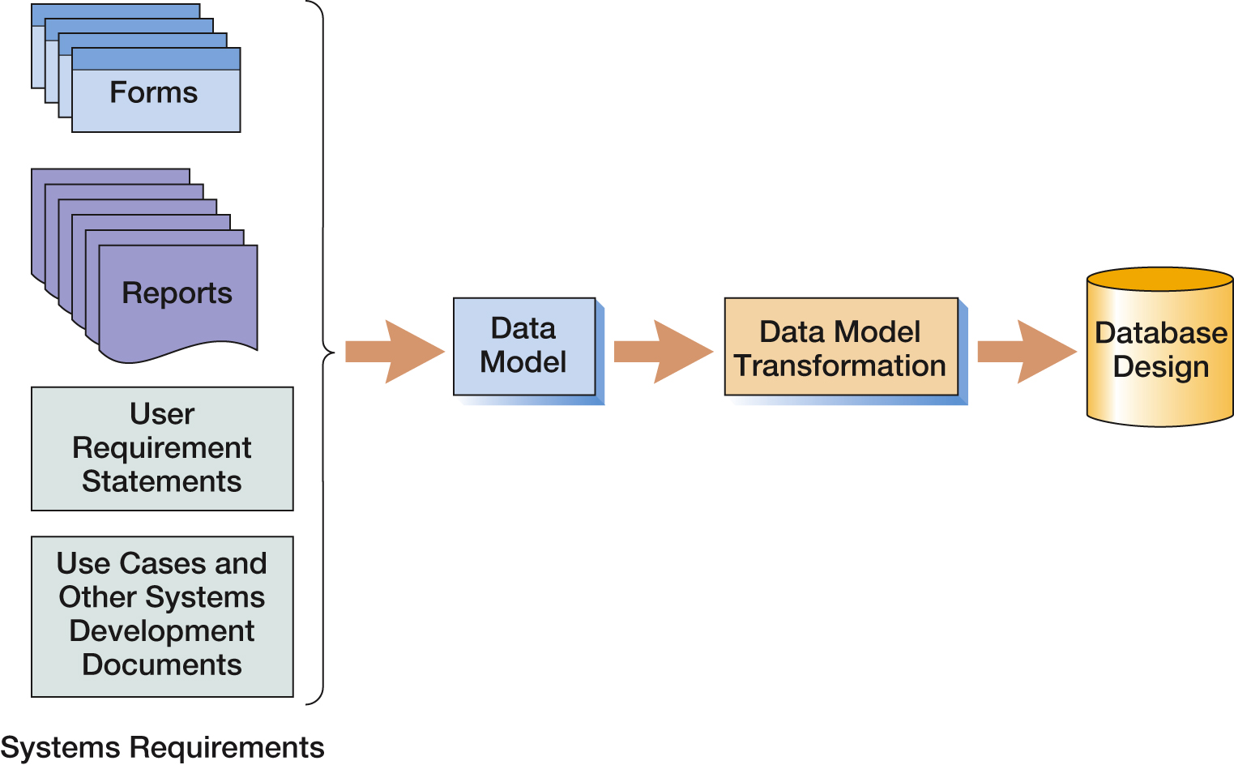
Database Originating from New Systems Development

Slide 19
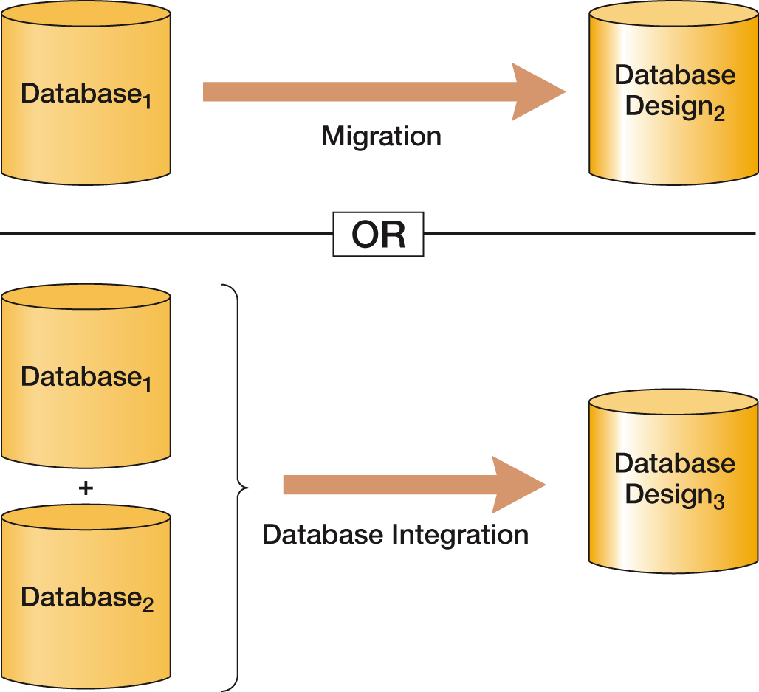
Databases Originating from Database Redesign

Slide 20
Database History (1 of 2)
Era | Years | Important Products | Remarks
Predatabase | Before 1970 | File Managers | All data were stored in separate files. Data integration was very difficult. File storage space was expensive and limited.
Early Database | 1970-1980 | ADABAS, System2000, Total, IDMS, IMS | First products to provide related tables. CODASYL DBTG and hierarchical data models (DL/I) were prevalent.
Emergence of relational model | 1978-1985 | DB2, Oracle Database, Ingres | Early relational DBMS products had substantial inertia to overcome. In time, the advantages weighed out.
Microcomputer DBMS products | 1982-1992+ | dBase-II, R:base, Paradox, Microsoft Access | Amazing! A database on a micro. All micro DBMS products were eliminated by Microsoft Access in the early 1990s.
Object-oriented DBMS | 1985-2000 | Oracle ODBMS, Gemstone, O2, Versant | Never caught on. Required relational database to be converted. Too much work for perceived benefit.

Slide 21
Database History (2 of 2)
Era | Years | Important Products | Remarks
Web Databases | 1995-Present | IIS, Apache, PHP, ASP.NET, and Java | Stateless characteristic of HTTP was a problem at first. Early applications were simple one-stage transactions. Later, more complex logic developed.
Open source DBMS products | 1995-Present | MySQL, PostgresQL, and other products | Open source DBMS products provide much of the functionality and features of commercial DBMS products at reduced cost.
XML, and Web services | 1998-Present | XML, SOAP, WSDL, UDDI, and other standards | XML provides tremendous benefits to Web-based database applications. Very important today. May replace relational databases during your career. See Chapter 11 and Appendix I.
Big Data and the NoSQL movement | 2009-present | Hadoop, Cassandra, Hbase, CouchDB, Arango DB, MongoDB, JSON and other products | Web applications such as Facebook and Twitter use Big Data technologies. The NoSQL movement is geared toward processing large data sets using NoSQL data models which replace relational databases with nonrelational data structures such as XML and JSON, and which may supplant relational databases during your career. See Chapter 12 and Appendices K and L.

Slide 22
The Relational Database Model
The dominant database model is the relational database model—all current major DBMS products are based on it.
It was created by IBM engineer E. F. Codd in 1970.
It was based on mathematics called relational algebra.

Slide 23
The NoSQL Movement and Big Data
Recent developments in Internet and mobile computing have resulted in the development of non-relational DBMSs.
NoSQL movement
Big Data
These do not replace the relational model, but rather complement it.

Slide 24
Database Processing Fundamentals, Design, and Implementation (15th Edition)
End of Presentation:
Week #1

Slide 25
Database Processing: Fundamentals, Design, and Implementation
15th Edition
Week #2
Part 1A
Introduction to Structured Query Language

Slide 26
Structured Query Language
Structured Query Language (SQL) was developed by the IBM Corporation in the late 1970’s.
SQL was endorsed as a U.S. national standard by the American National Standards Institute (ANSI) in 1992 [SQL-92].
Newer versions exist, such as SQL:2008, SQL:2011, and SQL:2016 and they incorporate new features including XML, JSON, and some object-oriented concepts. Some of these features are discussed in this book.

Slide 27
SQL As a Data Sublanguage
SQL is not a full-featured programming language.
C, C#
SQL is a data sublanguage for creating and processing database data and metadata.
SQL is ubiquitous in enterprise-class DBMS products.
SQL programming is a critical skill.

Slide 28
SQL Categories
SQL statements can be divided into five categories:
Data definition language (DDL)
Data manipulation language (DML) statements
SQL/Persistent Stored Modules (SQL/PSM) statements
Transaction control language (TCL) statements
Data control language (DCL) statements

Slide 29
SQL DDL
Data definition language (DDL) statements
Used for creating tables, relationships, and other structures

Slide 30
SQL DML
Data manipulation language (DML) statements
Used for:
Queries – SQL SELECT statement
Inserting data – SQL INSERT statement
Modifying data – SQL UPDATE statement
Deleting data – SQL DELETE statement

Slide 31
SQL SQL/PSM
SQL/Persistent Stored Modules (SQL/PSM) statements
Add procedural programming capabilities
Variables
Control-of-flow statements

Slide 32
SQL TCL and DCL
Transaction control language (TCL) statements
Used to mark transaction boundaries and control transaction behavior
Data control language (DCL) statements
Used to grant (or revoke) database permissions to (from) users and groups

Slide 33
Data Tables Used in Examples (1 of 2)
Table
RETAIL_ORDER
ORDER_ITEM
Column | Data Type
OrderNumber | Integer
StoreNumber | Integer
StoreZIP | Character (9)
OrderMonth | Character (12)
OrderYear | Integer
OrderTotal | Currency
OrderNumber | Integer
SKU | Integer
Quantity | Integer
Price | Currency
ExtendedPrice | Currency

Slide 34
Data Tables Used in Examples (2 of 2)
Table
SKU_DATA
BUYER
CATALOG_SKU_20##
Column | Data Type
SKU | Integer
SKU_Description | Character (35)
Department | Character (30)
Buyer | Character (35)
BuyerName | Character (35)
Department | Character (30)
Position | Character (10)
Supervisor | Character (35)
CatalogID | Integer
SKU | Integer
SKU_Description | Character (35)
Department | Character (30)
CatalogPage | Integer
DateOnWebSite | Date

Slide 35
The SQL SELECT Statement
The fundamental framework for an SQL query is the SQL SELECT statement.
SELECT {ColumnName(s)}
FROM {TableName(s)}
WHERE {Condition(s)}
All SQL statements end with a semicolon(;).

Slide 36
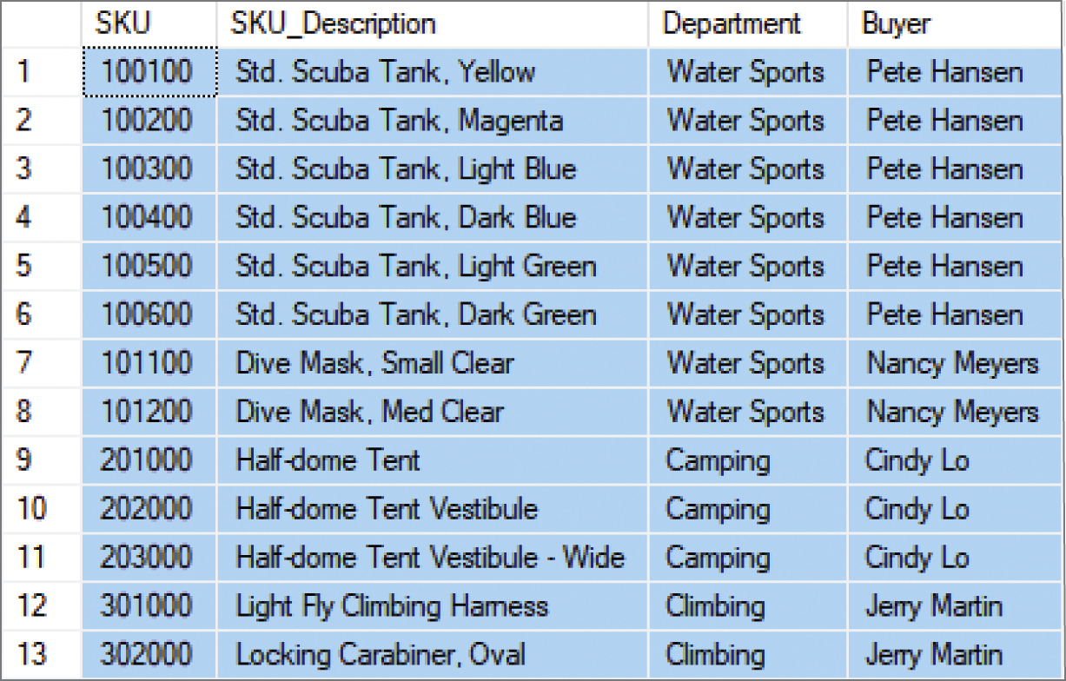
Specific Columns from a Single Table
SELECT SKU, SKU_Description, Department, Buyer
FROM SKU_DATA;

Slide 37

Selecting All Columns: The SQL Asterisk (*) Wildcard Character
SELECT *
FROM SKU_DATA;

Slide 38
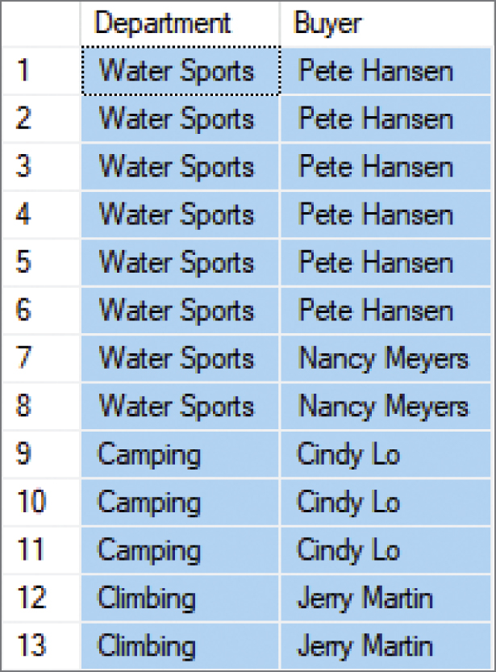
Specifying Column Order I
SELECT Department, Buyer
FROM SKU_DATA;

Slide 39
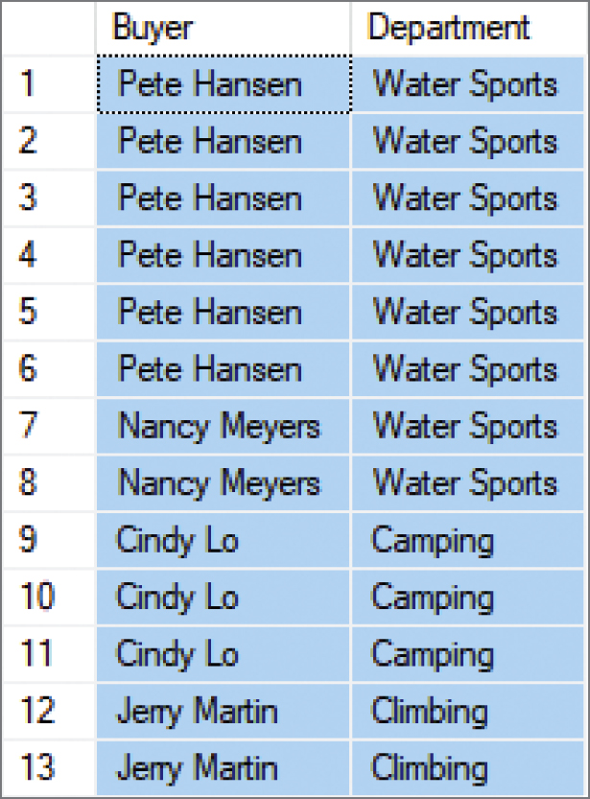
Specifying Column Order II
SELECT Buyer, Department
FROM SKU_DATA;

Slide 40
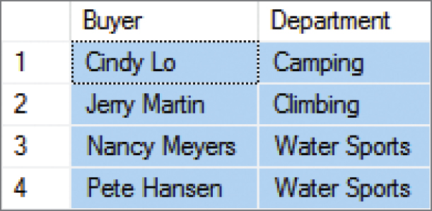
Reading Specified Rows from a Single Table The SQL DISTINCT Keyword
SELECT DISTINCT Buyer, Department
FROM SKU_DATA;

Slide 41
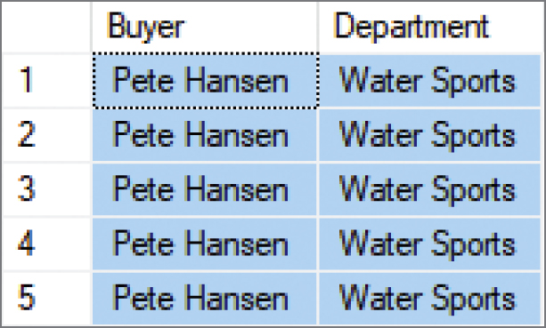
Controlling the Number of Rows from a Single Table I The SQL TOP {NumberOfRows} Function
SELECT TOP 5 Buyer, Department
FROM SKU_DATA;

Slide 42
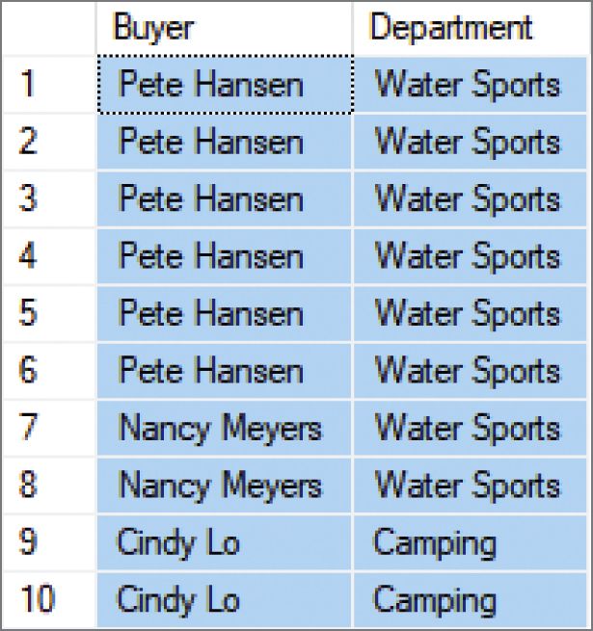
Controlling the Number of Rows from a Single Table II The SQL TOP {Percentage} PERCENT Function
SELECT TOP 75 PERCENT Buyer, Department
FROM SKU_DATA;

Slide 43
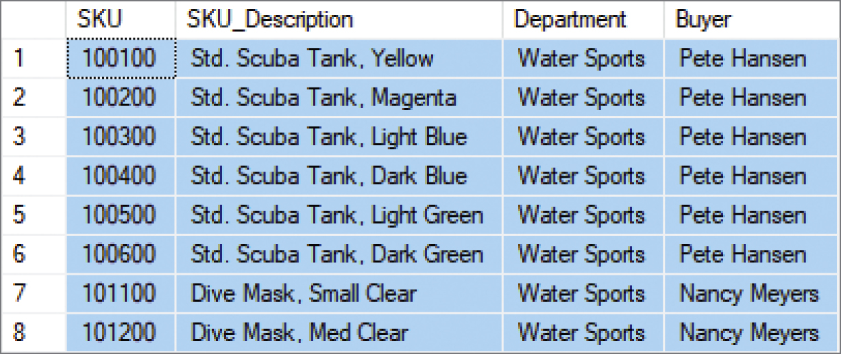
Controlling Specified Rows from a Single Table The SQL WHERE Clause: Character Strings
SELECT *
FROM SKU_DATA
WHERE Department = 'Water Sports';

Slide 44
SQL Comparison Operators
SQL Comparison Operators
Operator | Meaning
= | Is equal to
<> | Is NOT Equal to
< | Is less than
> | Is greater than
<= | Is less than OR equal to
>= | Is greater than OR equal to
IN | Is equal to one of a set of values
NOT IN | Is NOT equal to one of a set of values
BETWEEN | Is within a range of numbers (includes the end points)
NOT BETWEEN | Is NOT within a range of numbers (includes the end points)
LIKE | Matches a sequence of characters
NOT LIKE | Does NOT match a sequence of characters
IS NULL | Is equal to NULL
IS NOT NULL | Is NOT equal to NULL

Slide 45
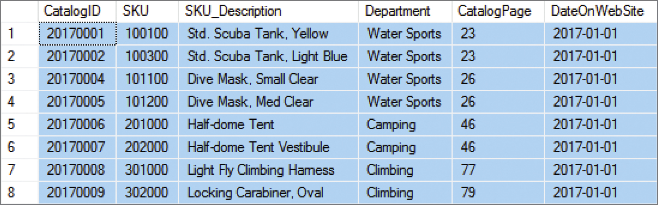
Reading Specified Rows from a Single Table I The SQL WHERE Clause: Dates
SELECT *
FROM CATALOG_SKU_2017
WHERE DateOnWebSite = '01-JAN-2017';

Slide 46
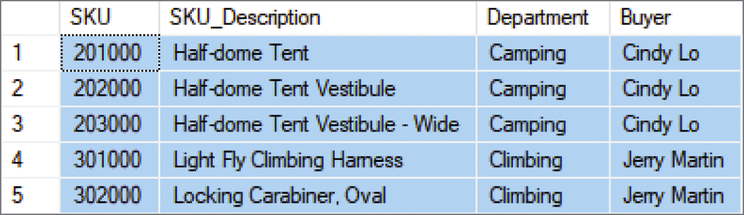
Reading Specified Rows from a Single Table II The SQL WHERE Clause: Numbers
SELECT *
FROM SKU_DATA
WHERE SKU > 200000;

Slide 47
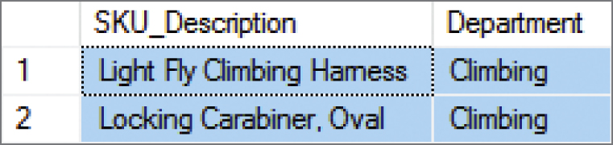
Reading Specified Columns and Rows from a Single Table I Column Names and the SQL WHERE Clause
SELECT SKU_Description, Department
FROM SKU_DATA
WHERE Department = 'Climbing';

Slide 48
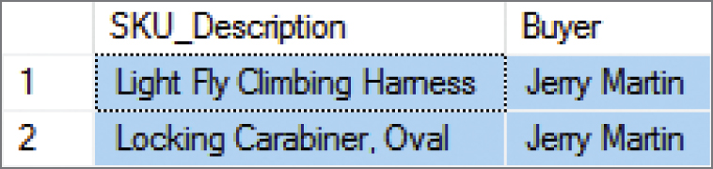
Reading Specified Columns and Rows from a Single Table II Column Names and the SQL WHERE Clause
SELECT SKU_Description, Buyer
FROM SKU_DATA
WHERE Department = 'Climbing’;
SQL does not require that the column used in the WHERE clause also appear in the SELECT clause column list as seen above.

Slide 49
Database Processing Fundamentals, Design, and Implementation (15th Edition)
End of Presentation:
Week #2
Part 1A

Slide 50
Database Processing: Fundamentals, Design, and Implementation
15th Edition
Week #3
Part 1B
Introduction to Structured Query Language

Slide 51
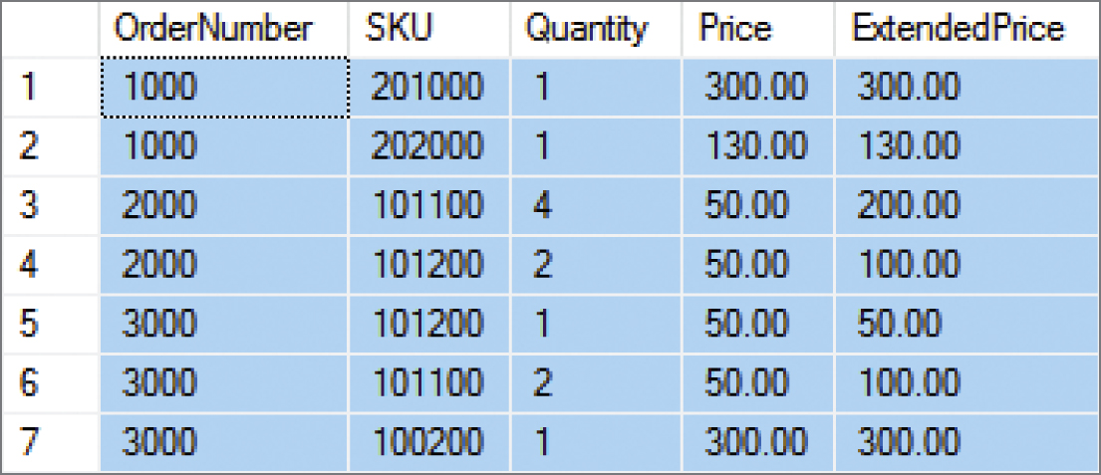
Sorting the SQL Query Results I The SQL ORDER BY Clause
SELECT *
FROM ORDER_ITEM
ORDER BY OrderNumber;

Slide 52
Sorting the SQL Query Results II Ascending and Descending Sort Order
SELECT *
FROM ORDER_ITEM
ORDER BY Price DESC, OrderNumber ASC;

Slide 53
SQL Logical Operators
SQL Logical Operators
Operator | Meaning
AND | Both conditions are TRUE
OR | One of the other or both conditions are TRUE
NOT | Negates the associated condition

Slide 54
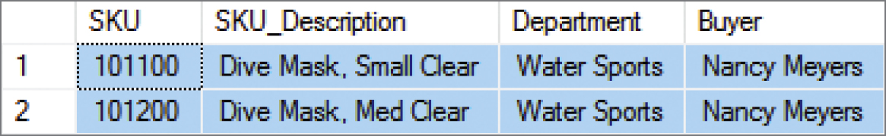
SQL WHERE Clause Options II SQL AND Operator
SELECT *
FROM SKU_DATA
WHERE Department='Water Sports’
AND Buyer='Nancy Meyers';

Slide 55

SQL WHERE Clause Options III SQL OR Operator
SELECT *
FROM SKU_DATA
WHERE Department='Camping’
OR Department='Climbing';

Slide 56
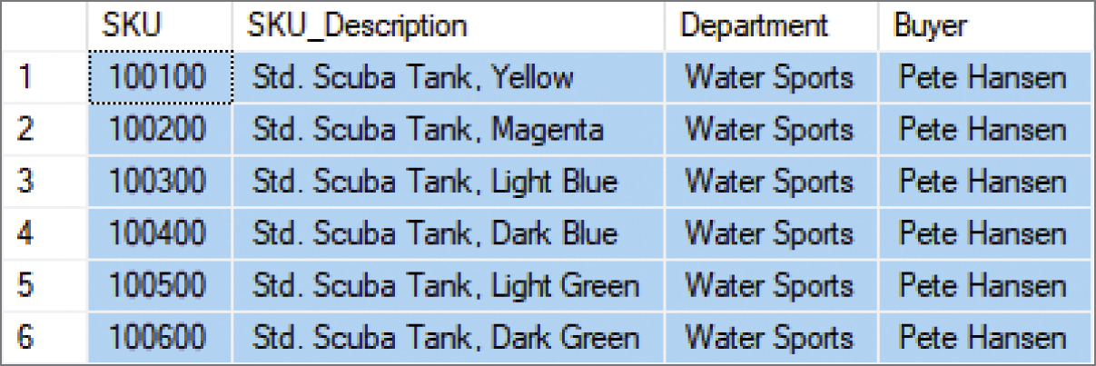
SQL WHERE Clause Options IV SQL NOT Operator
SELECT *
FROM SKU_DATA
WHERE Department='Water Sports’
AND NOT Buyer='Nancy Meyers';

Slide 57
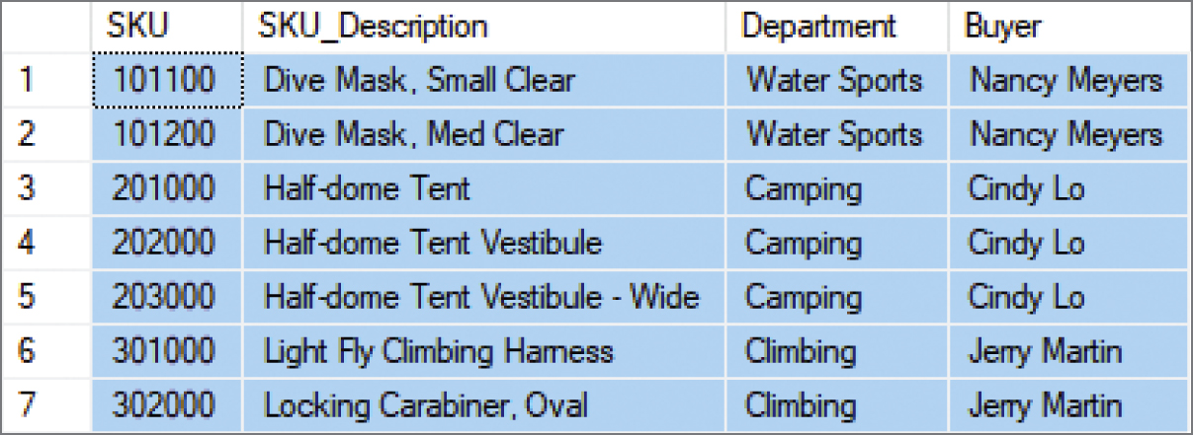
SQL WHERE Clause Options V Sets of Values: SQL IN Operator
SELECT *
FROM SKU_DATA
WHERE Buyer IN ('Nancy Meyers', 'Cindy Lo', 'Jerry Martin');

Slide 58
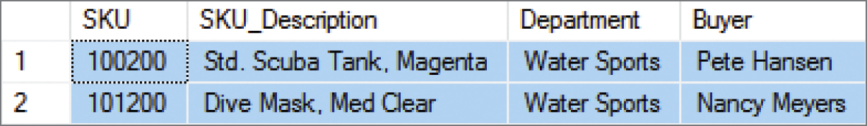
SQL WHERE Clause Options VI Sets of Values: SQL NOT IN Operator
SELECT *
FROM SKU_DATA
WHERE Buyer NOT IN ('Nancy Meyers', 'Cindy Lo', 'Jerry Martin');

Slide 59
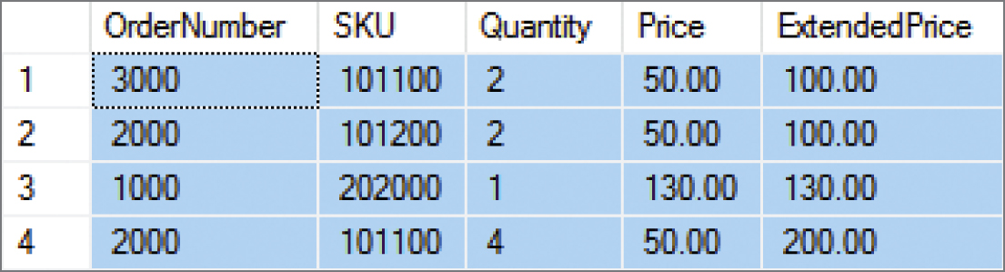
SQL WHERE Clause Options VII Ranges of Values: Using Math Symbols
SELECT *
FROM ORDER_ITEM
WHERE ExtendedPrice >= 100
AND ExtendedPrice <= 200
ORDER BY ExtendedPrice;

Slide 60
SQL WHERE Clause Options VIII Ranges of Values: SQL BETWEEN Operator
SELECT *
FROM ORDER_ITEM
WHERE ExtendedPrice BETWEEN 100 AND 200 ORDER BY ExtendedPrice;

Slide 61
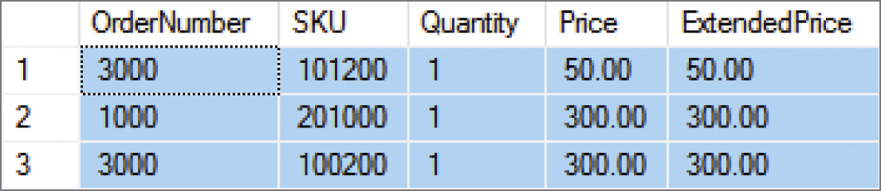
SQL WHERE Clause Options IX Ranges of Values: SQL NOT BETWEEN Operator
SELECT *
FROM ORDER_ITEM
WHERE ExtendedPrice NOT BETWEEN 100 AND 200
ORDER BY ExtendedPrice;

Slide 62
SQL WHERE Clause Options X Character String Patterns: SQL Wildcard Characters
The SQL LIKE operator and SQL NOT LIKE operator can be combined with wildcard symbols:
the SQL underscore (_) wildcard character, which represents a single, unspecified character in a specific position in the character string
the SQL percent sign (%) wildcard character, which represents any sequence of contiguous, unspecified characters (including spaces) in a specific position in the character string

Slide 63

SQL WHERE Clause Options XI Character String Patterns: SQL Like Operator I
SELECT *
FROM SKU_DATA
WHERE Buyer LIKE 'Pete%';

Slide 64
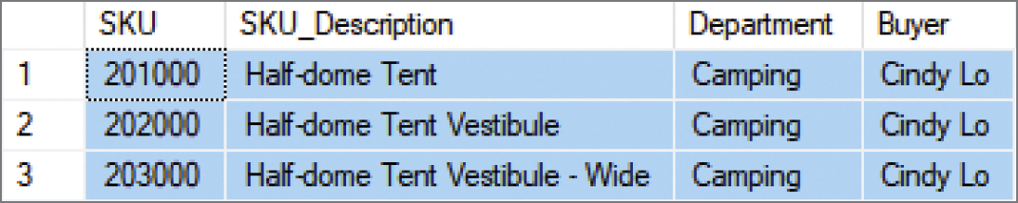
SQL WHERE Clause Options XII Character String Patterns: SQL Like Operator II
SELECT *
FROM SKU_DATA
WHERE SKU_Description LIKE '%Tent%';

Slide 65
SQL WHERE Clause Options XIII Character String Patterns: SQL Like Operator III
SELECT *
FROM SKU_DATA
WHERE SKU LIKE '%2__';

Slide 66
SQL WHERE Clause Options XIV Using NULL Values: SQL IS NULL Operator
SELECT *
FROM CATALOG_SKU_2017
WHERE CatalogPage IS NULL;

Slide 67

SQL WHERE Clause Options XV Using NULL Values: SQL IS NOT NULL Operator
SELECT *
FROM CATALOG_SKU_2017
WHERE CatalogPage IS NOT NULL;

Slide 68
SQL Built-in Aggregate Functions
SQL Built-in Aggregate Functions
Function | Meaning
COUNT(*) | Count the number of rows in a table
COUNT ({Name}] | Count the number of rows in the table where column {Name} IS NOT NULL
SUM | Calculate the sum of all values (numeric columns only)
AVG | Calculate the average of all values (numeric columns only)
MIN | Calculate the minimum value of all values
MAX | Calculate the maximum value of all values

Slide 69
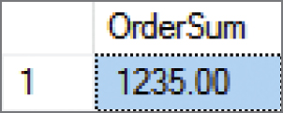
Performing Calculations in SQL Queries Using SQL Built-in Aggregate Functions: SUM
SELECT SUM(OrderTotal) AS OrderSum
FROM RETAIL_ORDER;

Slide 70
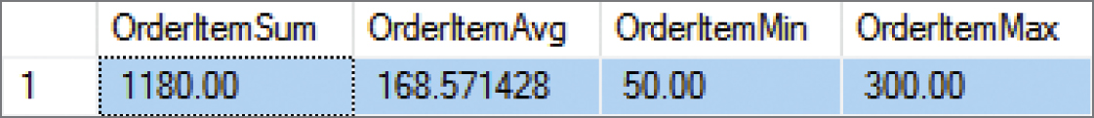
Performing Calculations in SQL Queries Using SQL Built-in Aggregate Functions: SUM, AVG, MIN AND MAX
SELECT SUM(ExtendedPrice) AS OrderItemSum,
AVG(ExtendedPrice) AS OrderItemAvg,
MIN(ExtendedPrice) AS OrderItemMin,
MAX(ExtendedPrice) AS OrderItemMax
FROM ORDER_ITEM;

Slide 71
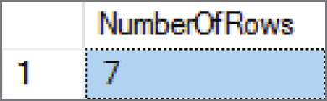
Performing Calculations in SQL Queries Using SQL Built-in Aggregate Functions: COUNT(*)
SELECT COUNT(*) AS NumberOfRows
FROM ORDER_ITEM;

Slide 72
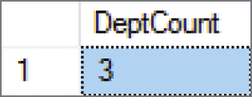
Performing Calculations in SQL Queries Using SQL Built-in Aggregate Functions: COUNT({Name})
SELECT COUNT(DISTINCT Department) AS DeptCount
FROM SKU_DATA;

Slide 73
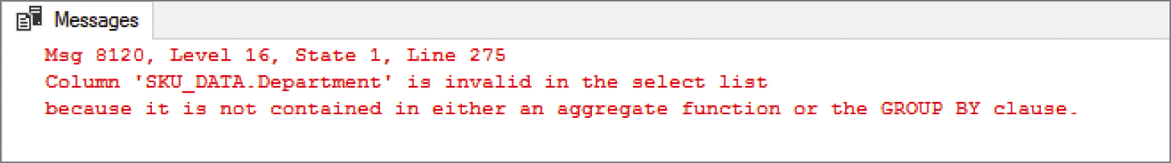
Performing Calculations in SQL Queries SQL Expressions I
You should be aware of two limitations to SQL built-in functions:
1) You cannot combine table column names with an SQL built-in function.
SELECT Department, COUNT(*)
FROM SKU_DATA;

Slide 74
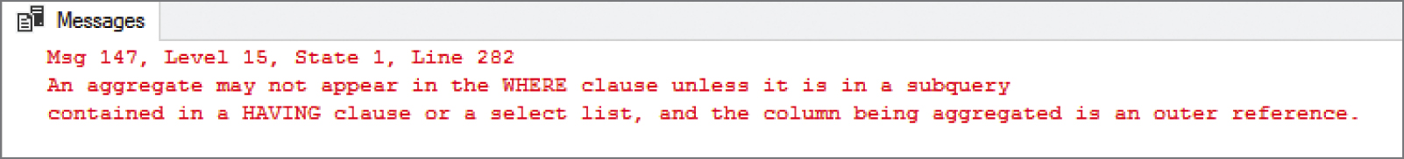
Performing Calculations in SQL Queries SQL Expressions II
2) You cannot use them (table names) in an SQL WHERE clause because the SQL WHERE clause operates on rows (choosing which rows will be displayed), whereas the aggregate functions operate on columns.
SELECT *
FROM RETAIL_ORDER
WHERE OrderTotal > AVG(OrderTotal);

Slide 75
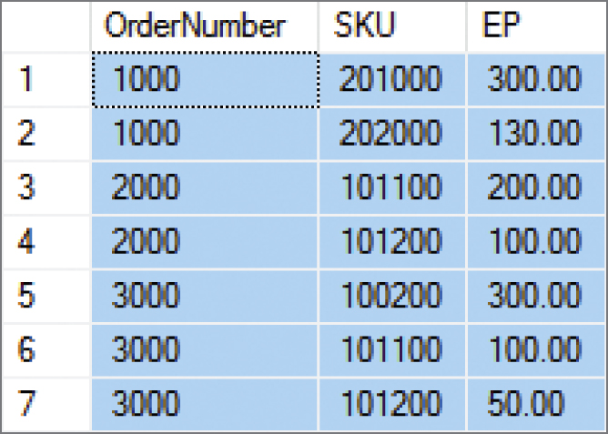
Performing Calculations in SQL Queries Using SQL Expressions I
SELECT OrderNumber, SKU, (Quantity * Price) AS EP
FROM ORDER_ITEM
ORDER BY OrderNumber, SKU;

Slide 76
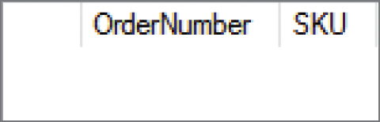
Performing Calculations in SQL Queries Using SQL Expressions II
SELECT OrderNumber, SKU
FROM ORDER_ITEM
WHERE Quantity * Price) <> ExtendedPrice
ORDER BY OrderNumber, SKU;

Slide 77
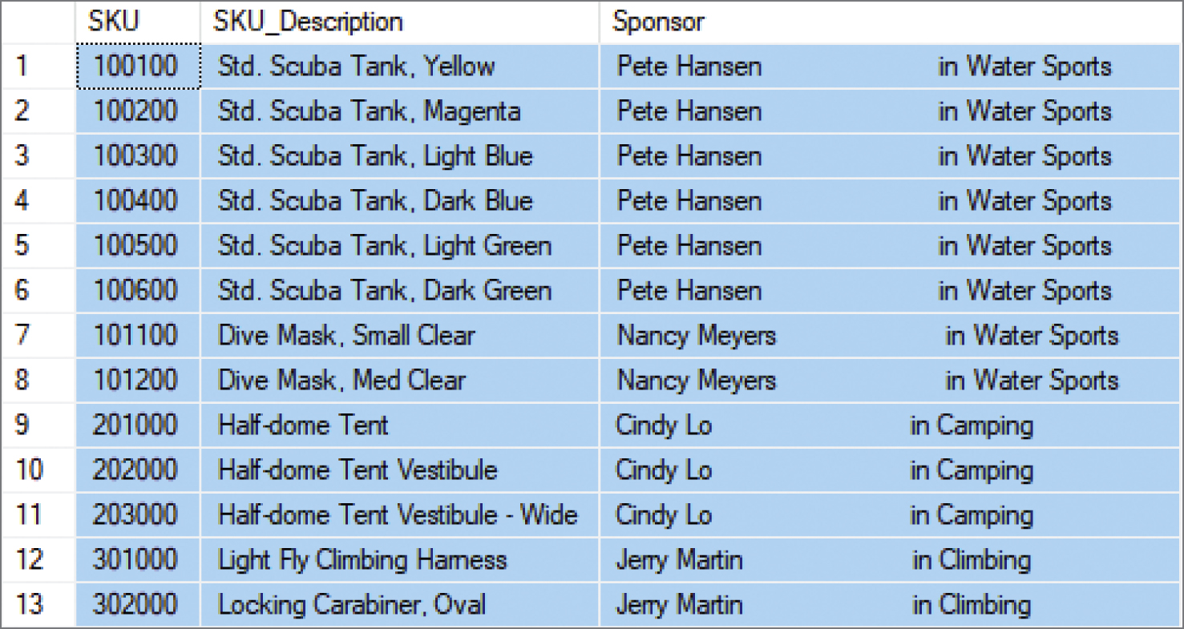
Performing Calculations in SQL Queries Using SQL Expressions with String Functions: Concatenation
SELECT SKU, SKU_Description, (Buyer+' in '+Department) AS Sponsor
FROM SKU_DATA
ORDER BY SKU;

Slide 78
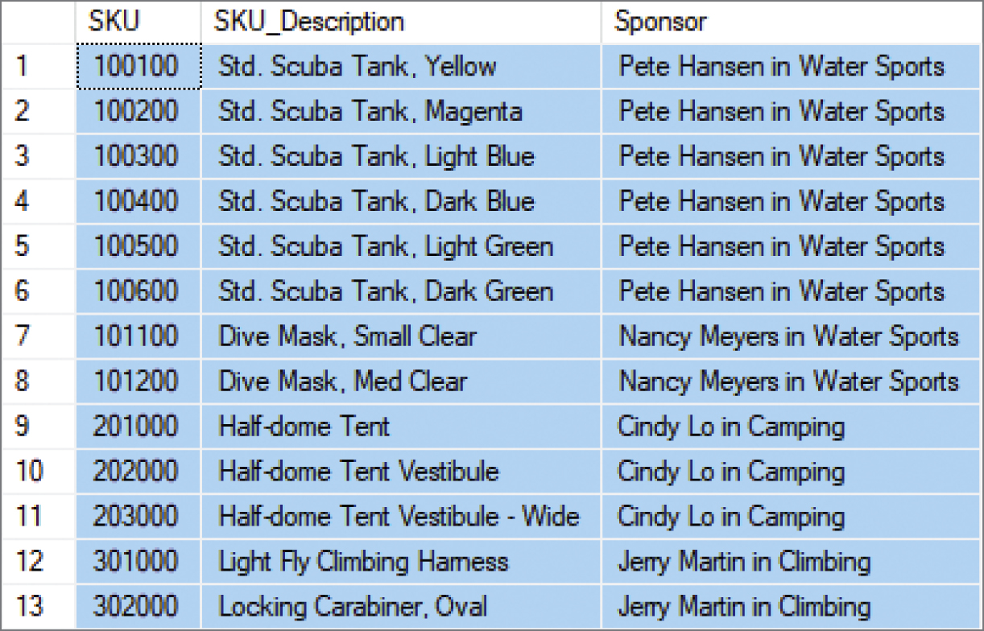
Performing Calculations in SQL Queries Using SQL Expressions with String Functions: Concatenation
SELECT SKU, SKU_Description, RTRIM(Buyer)+' in ‘ +RTRIM(Department) AS Sponsor
FROM SKU_DATA
ORDER BY SKU;

Slide 79
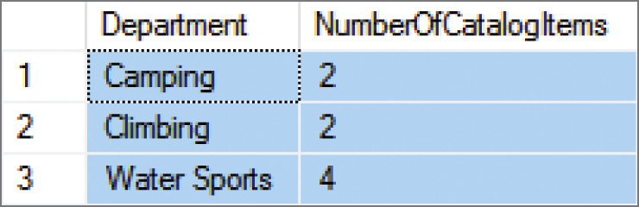
Grouping Rows in SQL Queries The SQL GROUP BY Clause
SELECT Department, COUNT(SKU) AS NumberOfCatalogItems
FROM CATALOG_SKU_2017
WHERE CatalogPage IS NOT NULL
GROUP BY Department;

Slide 80
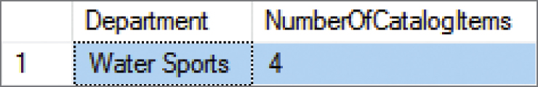
Grouping Rows in SQL Queries The SQL HAVING Clause
SELECT Department, COUNT(SKU) AS NumberOfCatalogItems
FROM CATALOG_SKU_2017
WHERE CatalogPage IS NOT NULL
GROUP BY Department
HAVING COUNT(SKU) > 2;

Slide 81
Grouping Rows in SQL Queries
The SQL WHERE clause specifies which rows will be used to determine the groups.
The SQL HAVING clause specifies which groups will be used in the final result.
In general, place WHERE before GROUP BY. Some DBMS products do not require that placement; but to be safe, always put WHERE before GROUP BY.
There is an ambiguity in statements that include both WHERE and HAVING clauses. The results can vary, so to eliminate this ambiguity SQL always applies WHERE before HAVING.

Slide 82
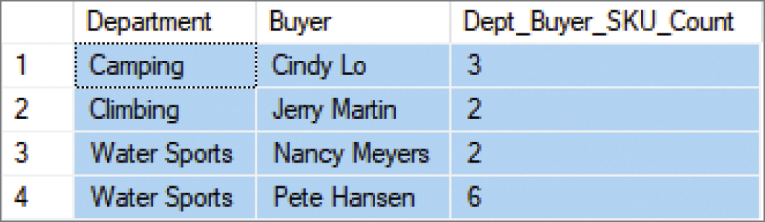
Grouping Rows in SQL Queries Grouping by More Than One Column
SELECT Department, Buyer, COUNT(SKU) AS Dept_Buyer_SKU_Count
FROM SKU_DATA
GROUP BY Department, Buyer;

Slide 83
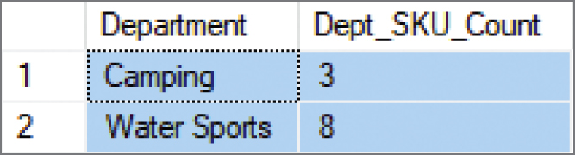
Grouping Rows in SQL Queries Using the SQL ORDER BY Clause with Groupings
SELECT Department, COUNT(SKU) AS Dept_SKU_Count
FROM SKU_DATA
WHERE SKU <> 302000
GROUP BY Department
HAVING COUNT(SKU) > 1
ORDER BY Dept_SKU_Count;

Slide 84
Database Processing Fundamentals, Design, and Implementation (15th Edition)
End of Presentation:
Week #3
Part 1B

Slide 85
Database Processing: Fundamentals, Design, and Implementation
15th Edition
Week #4
Part 2A
Introduction to Structured Query Language

Slide 86
Querying Two or More Tables with SQL
SQL provides two different techniques for querying data from multiple tables:
The SQL subquery
The SQL join
Although both work with multiple tables, they are used for slightly different purposes.

Slide 87
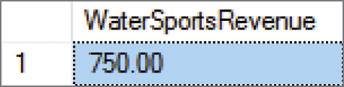
Querying Multiple Tables with SQL Subqueries (1 of 5) The Logic of Subqueries
We want to know the revenue for Water Sports items, which have SKU values of 100100, 100200, 101100, and 101200.
Given that we know the SKU values, we can use this query:
SELECT SUM(ExtendedPrice) AS WaterSportsRevenue
FROM ORDER_ITEM
WHERE SKU IN (100100, 100200, 100300, 100400, 100500, 100600, 101100, 101200);

Slide 88
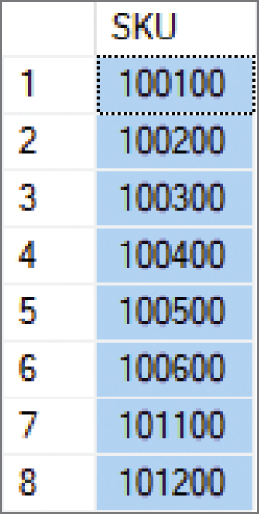
Querying Multiple Tables with SQL Subqueries (2 of 5) The Logic of Subqueries
What if we don’t know the SKU values? We can determine them with this query:
SELECT SKU
FROM SKU_DATA
WHERE Department = 'Water Sports';

Slide 89

Querying Multiple Tables with SQL Subqueries (3 of 5) The Logic of Subqueries
We can combine these two as shown below. The second query, which is enclosed in parentheses, is called an SQL subquery. Note how the subquery returns a set of values for use by the top level query, and note the use of the SQL IN keyword.
SELECT SUM(ExtendedPrice) AS WaterSportsRevenue
FROM ORDER_ITEM
WHERE SKU IN
(SELECT SKU
FROM SKU_DATA
WHERE Department = 'Water Sports');

Slide 90
Querying Multiple Tables with SQL Subqueries (4 of 5) The Logic of Subqueries
An SQL subquery is often described as:
A nested query
A query within a query
Note that SQL queries using subqueries are still effectively single table queries in the sense that only the columns of the top level query can be displayed in the query results!
Multiple subqueries can be used to process three or even more tables.
All parts if the SQL SELECT statement syntax can be applied to the table displaying the results of an SQL query using subqueries.

Slide 91
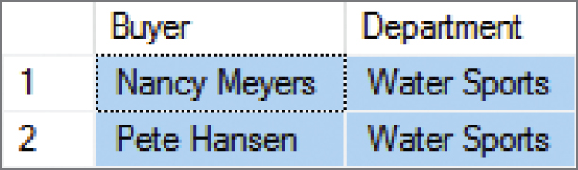
Querying Multiple Tables with SQL Subqueries (5 of 5) The Logic of Subqueries
SELECT DISTINCT Buyer, Department
FROM SKU_DATA
WHERE SKU IN
(SELECT SKU
FROM ORDER_ITEM
WHERE OrderNumber IN
(SELECT OrderNumber
FROM RETAIL_ORDER
WHERE OrderMonth = 'January’
AND OrderYear = 2018));

Slide 92
Querying Multiple Tables with SQL Joins (1 of 10) The Logic of Joins
In an SQL join operation, the SQL JOIN operator is used to combine parts or all of two or more tables.
Explicit join ─ the SQL JOIN operator is used as part of the SQL statement.
Implicit join ─ the SQL JOIN operator is not used as part of the SQL statement.

Slide 93
Querying Multiple Tables with SQL Joins (2 of 10) SQL CROSS JOIN
An SQL CROSS JOIN combines each row in one table with every row in another table.
SELECT *
FROM RETAIL_ORDER, ORDER_ITEM;
This is known mathematically as a Cartesian product of the rows in the tables.
This is illogical in database work because we only need rows that somehow logically correspond in the two tables.

Slide 94
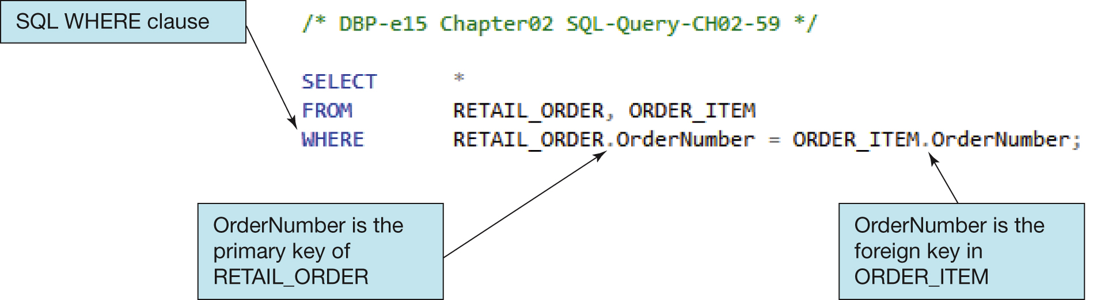
Querying Multiple Tables with SQL Joins (3 of 10) Implicit SQL INNER JOIN
By selecting rows by matching by the primary key values of one table with the foreign key values of a second table, we produce an SQL INNER JOIN.
Because the SQL JOIN keyword does not appear in the SQL statement, this is an implicit join.

Slide 95
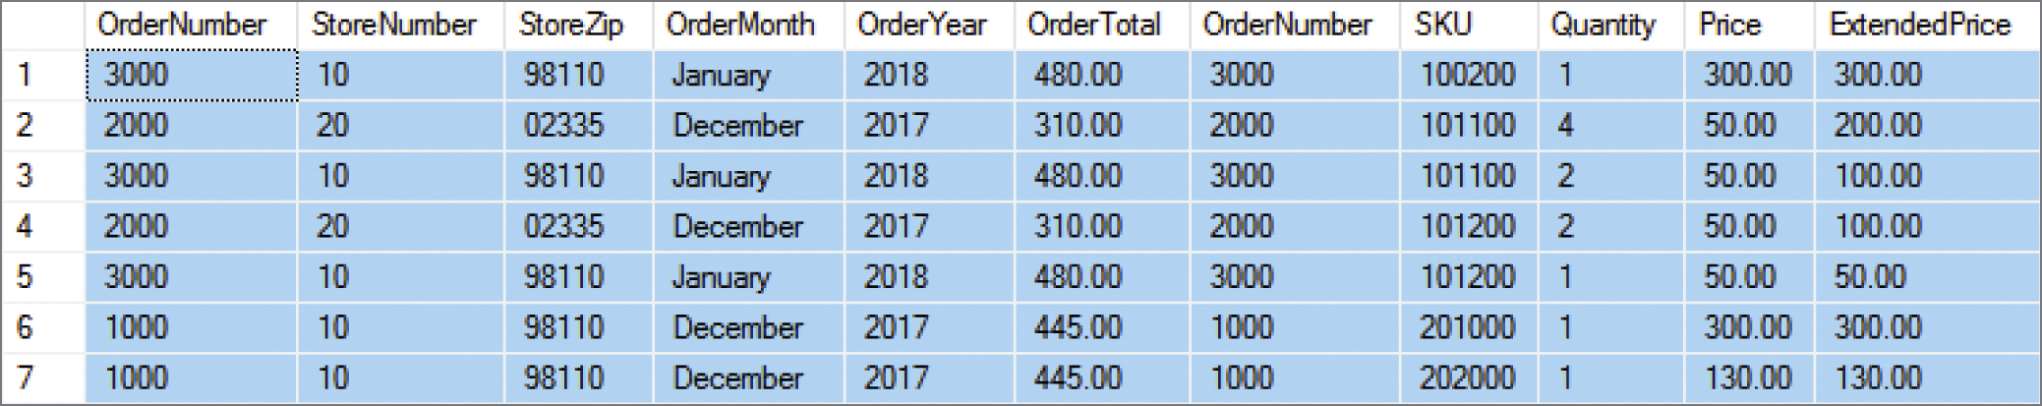
Querying Multiple Tables with SQL Joins (4 of 10) Implicit SQL INNER JOIN
SELECT *
FROM RETAIL_ORDER, ORDER_ITEM
WHERE RETAIL_ORDER.OrderNumber = ORDER_ITEM.OrderNumber;

Slide 96
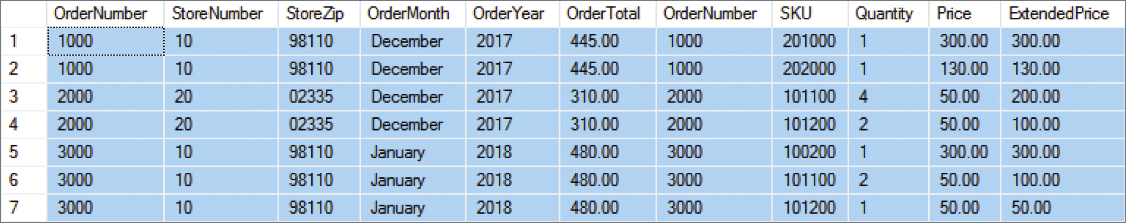
Querying Multiple Tables with SQL Joins (5 of 10) Implicit SQL INNER JOIN
With an SQL ORDER BY clause for easier reading by OrderNumber:
SELECT *
FROM RETAIL_ORDER, ORDER_ITEM
WHERE RETAIL_ORDER.OrderNumber = ORDER_ITEM.OrderNumber ORDER BY RETAIL_ORDER.OrderNumber, ORDER_ITEM.SKU;

Slide 97
Querying Multiple Tables with SQL Joins (6 of 10) EQUIJOIN
The process of using an SQL JOIN operation to join two tables is called joining the two tables.
When tables are joined using an equal to condition as in the example above, the join is called an equijoin.
When people say “join,” 99.99999 percent of the time they mean equijoin.
Multiple joins can be used to process three or even more tables.
All parts of the SQL SELECT statement syntax can be applied to the table displaying the results of an SQL query using joins.

Slide 98
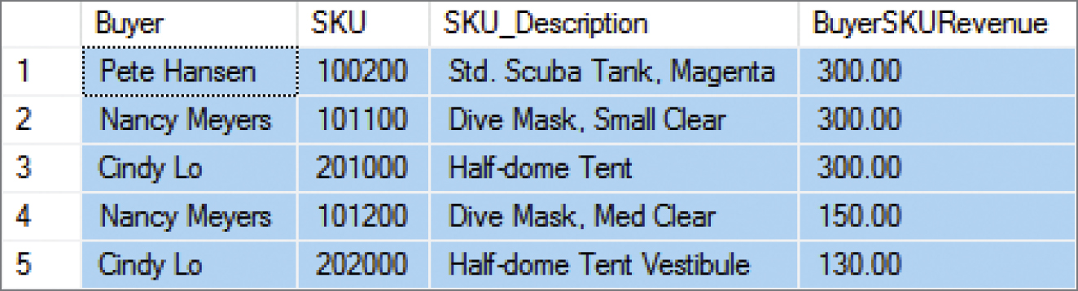
Querying Multiple Tables with SQL Joins (7 of 10) The Logic of Joins
SELECT Buyer, SKU_DATA.SKU, SKU_Description,
SUM(ExtendedPrice) AS BuyerSKURevenue
FROM SKU_DATA, ORDER_ITEM
WHERE SKU_DATA.SKU = ORDER_ITEM.SKU
GROUP BY Buyer, SKU_DATA.SKU, SKU_Description
ORDER BY BuyerSKURevenue DESC;

Slide 99
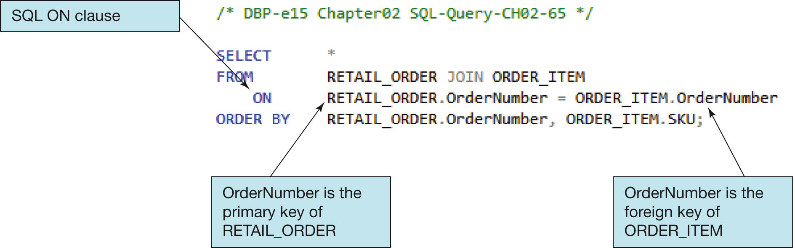
Querying Multiple Tables with SQL Joins (8 of 10) Explicit SQL INNER JOIN
Selecting rows by matching by the primary key values of one table with the foreign key values of a second table, we produce an SQL INNER JOIN.
Because the SQL JOIN keyword does appear in the SQL statement, this is an explicit join.

Slide 100
Querying Multiple Tables with SQL Joins (9 of 10) SQL JOIN ON Syntax
In SQL JOIN ON syntax:
The SQL JOIN keyword is placed between the table names in the SQL FROM clause, where it replaces the comma that previously separated the two table names.
The SQL ON keyword now leads into an SQL ON clause, which includes the statement of matching key values that was previously in an SQL WHERE clause.
The SQL WHERE clause is no longer used as part of the join, which makes it easier to read the actual restrictions on the rows in the query in the SQL WHERE clause itself.
The explicit SQL JOIN ON syntax is currently considered as the proper way to write SQL join operations, and the older implicit SQL syntax is considered an archaic, older syntax (but it still works).

Slide 101
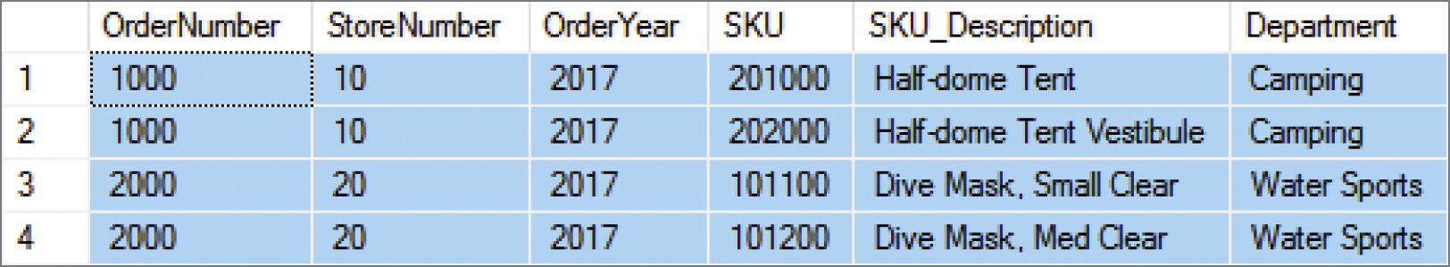
Querying Multiple Tables with SQL Joins (10 of 10) The Logic of Joins
SELECT *
FROM RETAIL_ORDER JOIN ORDER_ITEM
ON RETAIL_ORDER.OrderNumber = ORDER_ITEM.OrderNumber WHERE OrderYear = 2017
ORDER BY RETAIL_ORDER.OrderNumber, ORDER_ITEM.SKU;

Slide 102
Database Processing Fundamentals, Design, and Implementation (15th Edition)
End of Presentation:
Week #4
Part 2A

Slide 103
Database Processing: Fundamentals, Design, and Implementation
15th Edition
Week #5
Part 2B
Introduction to Structured Query Language

Slide 104
SQL Subqueries versus SQL Joins
SQL subqueries and SQL joins both process multiple tables.
An SQL subquery can only be used to retrieve data from the “top table.”
An SQL join can be used to obtain data from any number of tables, including the “top table” of the subquery.
In Chapter 8, we will study the correlated subquery. That kind of subquery can do work that is not possible with joins.

Slide 105
SQL Queries on Recursive Relationships (1 of 3)
Recursive means that something recurs or repeats.
A recursive procedure (in computer programming languages) is a block of code that calls itself.
A recursive relationship (in database structures) is a relationship between two columns in the same table.

Slide 106
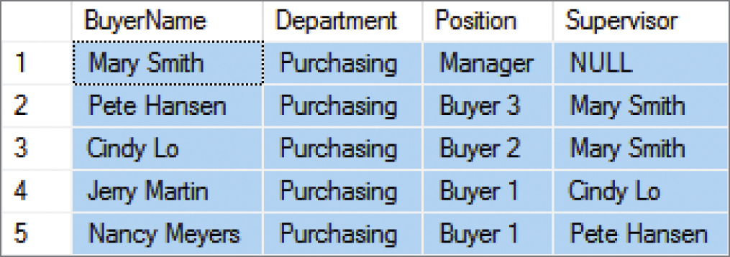
SQL Queries on Recursive Relationships (2 of 3)
In the Cape Codd Outdoor Sports data extract below, the BUYER table has a recursive relationship: the Supervisor column holds value of the BuyerName column as data and serves as a foreign key referencing BuyerName as the associated primary key.
SELECT BuyerName, Department, Position, Supervisor
FROM BUYER
ORDER BY Position DESC;

Slide 107

SQL Queries on Recursive Relationships (3 of 3)
The solution is to use table aliases to create two aliased versions of the same single table. Thus, the query below lists each BuyerName and that person’s Supervisor:
SELECT S.BuyerName AS SupervisorName, S.Position AS SupervisorPosition, B.BuyerName, B.Position
FROM BUYER S JOIN BUYER B
ON S.BuyerName = B.Supervisor ORDER BY S.BuyerName;

Slide 108

The Logic of Outer Joins – Example Tables

Slide 109

INNER JOIN (STUDENT and LOCKER Tables)

Slide 110

LEFT OUTER JOIN (STUDENT and LOCKER Tables)

Slide 111

RIGHT OUTER JOIN (STUDENT and LOCKER Tables)

Slide 112

SQL RIGHT OUTER JOIN Example
SELECT OI.OrderNumber, Quantity, SD.SKU, SKU_Description, Department, Buyer
FROM ORDER_ITEM AS OI RIGHT OUTER JOIN SKU_DATA AS SD ON OI.SKU = SD.SKU
ORDER BY OI.OrderNumber, SD.SKU;

Slide 113
Mathematical Set Theory
Mathematicians use the term set theory to describe mathematical operations on sets, where a set is defined as a group of distinct items.
A relational database table meets the definition of a set, so it is little wonder that SQL includes a group of set operators for use with SQL queries.

Slide 114
Venn Diagrams (1 of 2)
Venn diagrams are the standard method of visualizing sets and their relationships.
A set is represented by a labeled circle.
A subset is a portion of a set that is contained entirely within the set.
The union of two sets represents a set that contains all values in both sets. This is equivalent to an OR logical operation (A OR B).
The intersection of two sets represents the area common to both sets. This is equivalent to an AND logical operation (A AND B).
The complement of set B in set A represents everything in set A that is not in set B. This is equivalent to a logical operation using NOT (A NOT B).

Slide 115

Venn Diagrams (2 of 2)

Slide 116

SQL Set Operators
Note that in order to use SQL set operators, the table columns involved in the operations must be the same number in each SELECT component, and corresponding columns must have the same or compatible (e.g., CHAR and VARCHAR) data types!

Slide 117

SQL UNION Operator
“What products were available for sale (by either catalog or Web site) in 2017 and 2018?”
SELECT SKU, SKU_Description, Department
FROM CATALOG_SKU_2017
UNION
SELECT SKU, SKU_Description, Department
FROM CATALOG_SKU_2018;

Slide 118
SQL ALL Keyword
If we compare the output of the query on the previous slide referring to the data in CATALOG-SKU_2017 and CATALOG_SKU_2018, we will note that there are no duplicate rows in the query output. For example, SKU 201000, the Half-Dome Tent, is actually in each table, but only appears once in the query output. If, for some reason, we wanted the duplicated rows to be displayed in the query output as well, we would simply add the SQL ALL keyword to the query:
SELECT SKU, SKU_Description, Department
FROM CATALOG_SKU_2017
UNION ALL
SELECT SKU, SKU_Description, Department
FROM CATALOG_SKU_2018;

Slide 119

SQL INTERSECT Operator
“What products were available for sale (by either catalog or Web site) in both 2017 and 2018?” [MySQL 5.6 does not support the INTERSECT Operator]
SELECT SKU, SKU_Description, Department
FROM CATALOG_SKU_2017
INTERSECT
SELECT SKU, SKU_Description, Department
FROM CATALOG_SKU_2018;

Slide 120

SQL EXCEPT Operator
“What products were available for sale (by either catalog or Web site) in 2017 but not in 2018?” [Oracle Database calls this the SQL MINUS operator, and MySQL 5.6 does not support this operation]
SELECT SKU, SKU_Description, Department
FROM CATALOG_SKU_2017
EXCEPT
SELECT SKU, SKU_Description, Department
FROM CATALOG_SKU_2018;

Slide 121
Database Processing Fundamentals, Design, and Implementation (15th Edition)
End of Presentation:
Week #5
Part 2B

Slide 122
Database Processing: Fundamentals, Design, and Implementation
15th Edition
Week #6
SQL for Database Construction and Application Processing

Slide 123
SQL Categories
SQL statements can be divided into five categories:
Data definition language (DDL)
Data manipulation language (DML) statements
SQL/Persistent Stored Modules (SQL/PSM) statements
Transaction control language (TCL) statements
Data control language (DCL) statements

Slide 124
SQL DDL and SQL DML
Data definition language (DDL) statements
Used for creating tables, relationships, and other structures
Data manipulation language (DML) statements
Used for:
Queries – SQL SELECT statement
Inserting data – SQL INSERT statement
Modifying data – SQL UPDATE statement
Deleting data – SQL DELETE statement

Slide 125

View Ridge Gallery (VRG) Database Design

Slide 126
The SQL CREATE TABLE Statement
CREATE TABLE statement is used for creating relations.
Each column is described with three parts: column name, data type, and optional constraints.
CREATE TABLE NewTableName(
ColumnName DataType OptionalConstraint,
ColumnName DataType OptionalConstraint,
...
Optional table constraint
...
);

Slide 127
Column and Table Constraints
Constraints can be defined within the CREATE TABLE statement, or they can be added to the table after it is created using the ALTER table statement.
Column and table constraints include:
PRIMARY KEY ─ may not have NULL values
FOREIGN KEY ─ may not have NULL values
NULL / NOT NULL
UNIQUE
CHECK
The DEFAULT keyword (not a constraint) can be used to set initial values.

Slide 128
Column Characteristics for the VRG ARTIST Table
Column Name | Type | Key | NULL Status | Remarks
ArtistID | Int | Primary Key | NOT NULL | Surrogate Key IDENTITY (1,1)
LastName | Char (25) | Alternate Key | NOT NULL | AK1.1
FirstName | Char (25) | Alternate Key | NOT NULL | AK1.2
Nationality | Char (30) | No | NULL
DateOfBirth | Numeric (4,0) | No | NULL
DateDeceased | Numeric (4, 0) | No | NULL

Slide 129
Column Characteristics for the VRG WORK Table
Column Name | Type | Key | NULL Status | Remarks
WorkID | Int | Primary Key | NOT NULL | Surrogate Key IDENTITY (500,1)
Title | Char (35) | Alternate Key | NOT NULL | AK1.1
Copy | Char (12) | Alternate Key | NOT NULL | AK1.2
Medium | Char (35) | No | NULL
Description | Varchar (1000) | No | NULL | DEFAULT value = ‘Unknown provenance’
ArtistID | Int | Foreign Key | NOT NULL

Slide 130

SQL Statement to Create the VRG ARTIST Table
SQL CREATE TABLE statement:

Slide 131

SQL Statement to Create the VRG ARTIST-to-WORK 1:N Relationship

Slide 132
Default Values and Data Constraints for the VRG Database
Table | Column | Default Value | Constraint
WORK | Description | ‘Unknown provenance’
ARTIST | Nationality |  | IN (‘Canadian’, ‘English’, ‘French’, German’, ‘Mexican’, ‘Russian’, ‘Spanish’, ‘United States’)
ARTIST | DateOfBirth |  | Less than DateDeceased
ARTIST | DateOfBirth |  | Four digits – 1 or 2 is first digit, 0 to 9 for remaining three digits.
ARTIST | DateDeceased |  | Four digits – 1 or 2 is first digit, 0 to 9 for remaining three digits.
TRANS | SalesPrice |  | Greater than 0 and less than or equal to 500,000.
TRANS | DateAcquired |  | Less than or equal to DateSold

Slide 133

SQL Statement to Create the ARTIST and WORK tables with Constraints

Slide 134

SQL Statements to Create the VRG CUSTOMER Table

Slide 135


SQL Statements to Create the VRG TRANS Table

Slide 136

SQL Statements to Create the VRG CUSTOMER_ARTIST_INT Table

Slide 137
The SQL ALTER TABLE Statement
The SQL ALTER TABLE statement is an SQL DDL statement that is used to change the structure of an existing table.
It can be used to add, remove, or change columns.
It can be used to add or remove constraints.

Slide 138
Adding and Dropping Columns
The following statement will add a column named MyColumn to the CUSTOMER table:
ALTER TABLE CUSTOMER
ADD MyColumn Char(5) NULL;
The following statement will drop an existing column:
ALTER TABLE CUSTOMER
DROP COLUMN MyColumn;
Note the SQL COLUMN keyword is used only when dropping a column and not when adding one!

Slide 139
Adding and Dropping Constraints
The SQL ADD CONSTRAINT can be used to add a constraint:
ALTER TABLE CUSTOMER
ADD CONSTRAINT MyConstraint CHECK
(LastName NOT IN ('Robertson'));
The SQL DROP CONSTRAINT can be used to drop a constraint:
ALTER TABLE CUSTOMER
DROP CONSTRAINT MyConstraint;

Slide 140
Removing Tables
It is easy to remove a table in SQL.
BUT, be very careful to drop the correct table because you also drop all of its data!
SQL code to drop a table:
DROP TABLE TRANS;

Slide 141
Dropping the CUSTOMER Table (1 of 2)
The following statement will drop the CUSTOMER table. Note that the other two tables need to be dropped also because of the constraints on the CUSTOMER table.
DROP TABLE CUSTOMER_ARTIST_INT;
DROP TABLE TRANS;
DROP TABLE CUSTOMER;

Slide 142
Dropping the CUSTOMER Table (2 of 2)
As an alternative, we can drop only the CUSTOMER table if we first drop the constraints associated with the other two tables as follows:
ALTER TABLE CUSTOMER_ARTIST_INT
DROP CONSTRAINT CAInt_CustomerFK;
ALTER TABLE TRANS
DROP CONSTRAINT TransCustomerFK;
DROP TABLE CUSTOMER;

Slide 143
The SQL TRUNCATE TABLE Statement
The SQL TRUNCATE TABLE statement is used to remove all data from a table while leaving the table structure intact as seen below:
TRUNCATE TABLE CUSTOMER_ARTIST_INT;
Cannot be used with a table that is referenced by a foreign key constraint.
Resets surrogate key values to their initial value.

Slide 144
The SQL INSERT Statement
The SQL INSERT Statement is used to add rows of data to an existing table.
INSERT INTO ARTIST
(LastName, FirstName, Nationality, DateOfBirth, DateDeceased)
VALUES ('Miro', 'Joan', 'Spanish', 1893, 1983);
INSERT INTO ARTIST
(LastName, FirstName, Nationality)
VALUES ('Miro', 'Joan', 'Spanish');

Slide 145
Using the Bulk INSERT
You can insert bulk data from another table by using the INSERT statement.
INSERT INTO ARTIST
(LastName, FirstName, Nationality, DateOfBirth, DateDeceased)
SELECT LastName, FirstName, Nationality,
DateOfBirth, DateDeceased
FROM IMPORTED_ARTIST;

Slide 146
The SQL UPDATE Statement
The SQL UPDATE Statement is used to change values of existing rows.
Example: Change the City value to ‘New York City’ in the VRG database for CustomerID = 1000.
UPDATE CUSTOMER
SET City = 'New York City’
WHERE CustomerID = 1000;
To change the value of both city and state:
UPDATE CUSTOMER
SET City = 'New York City', State = 'NY’
WHERE CustomerID = 1000;

Slide 147
The Bulk UPDATE (1 of 2)
UPDATE CUSTOMER
SET City = 'New York City’;
Warning! If you execute the above statement you will change every row in the CUSTOMER table.
Be sure to include a WHERE statement to show only those customers you really want to change!

Slide 148
The Bulk UPDATE (2 of 2)
Update the CUSTOMER table by changing the area code for every customer who lives in Denver to ‘303’.
UPDATE CUSTOMER
SET AreaCode = '303’
WHERE City = 'Denver’;
Notice the WHERE statement in the code above.

Slide 149
The SQL MERGE Statement (1 of 2)
The SQL MERGE Statement essentially combines the SQL INSERT and SQL UPDATE statements into one statement that can either insert or update data depending upon whether some condition is met.

Slide 150
The SQL MERGE Statement (2 of 2)
MERGE INTO ARTIST AS A USING ARTIST_DATA_RESEARCH AS ADR
ON (A.LastName = ADR.LastName
AND
A.FirstName = ADR.FirstName)
WHEN MATCHED THEN
UPDATE SET
A.Nationality = ADR.Nationality,
A.DateOfBirth = ADR.DateOfBirth,
A.DateDeceased = ADR.DateDeceased
WHEN NOT MATCHED THEN
INSERT (LastName, FirstName, Nationality, DateOfBirth, DateDeceased)
VALUES (ADR.LastName, ADR.FirstName,
ADR.Nationality, ADR.DateOfBirth, ADR.DateDeceased);

Slide 151
The SQL DELETE Statement
SQL DELETE statement:
DELETE FROM CUSTOMER
WHERE CustomerID = 1000;
If you omit the WHERE clause, you will delete every row in the table.
Does not reset surrogate key values

Slide 152
Using SQL Views
An SQL view is a virtual table that is constructed from other tables or views.
It has no data of its own, but obtains data from tables or other views.
SELECT statements are used to define views:
A view definition may not include an ORDER BY clause
SQL views are a subset of the external views:
They can be used only for external views that involve one multivalued path through the schema

Slide 153
SQL CREATE VIEW Statement (1 of 2)
Create the CustomeNameView on the CUSTOMER table that displays the customer’s LastName and FirstName and rename the fields.
CREATE VIEW CustomerNameView AS
SELECT LastName AS CustomerLastName,
FirstName AS CustomerFirstName
FROM CUSTOMER;
Views do NOT support the ORDER BY clause, thus you cannot sort within a view.

Slide 154

SQL CREATE VIEW Statement (2 of 2)
To see the results, use an SQL SELECT statement with the view name as the table name in the FROM clause as shown below.
SELECT *
FROM CustomerNameView
ORDER BY CustomerLastName,
CustomerFirstName;
Notice you can now sort!

Slide 155
The SQL ALTER VIEW Statement
You can use the ALTER VIEW Statement to change an SQL view after it has been created.
ALTER VIEW CustomerNameView AS
SELECT FirstName AS CustomerFirstName,
LastName AS CustomerLastName,
FROM CUSTOMER;

Slide 156
Database Processing Fundamentals, Design, and Implementation (15th Edition)
End of Presentation:
Week #6

Slide 157
Database Processing: Fundamentals, Design, and Implementation
15th Edition
Week #9 – Part 1
The Relational Model and Normalization

Slide 158
The Relational Model
Introduced in 1970
Created by E.F. Codd
IBM engineer
The model used mathematics known as “relational algebra”
Now the standard model for commercial DBMS products

Slide 159
Entity
An entity is some identifiable thing that users want to track:
Customers
Computers
Sales

Slide 160
Relation
Relational DBMS products store data about entities in relations, which are a special type of table.
A relation is a two-dimensional table that has the following characteristics:
Characteristics of Relations
Rows contain data about an entity.
Columns contain data about attributes of the entities.
All entries in a column are of the same kind.
Each column has a unique name.
Cells of the table hold a single value.
The order of the columns is unimportant.
The order of the rows is unimportant.
No two rows may be identical.

Slide 161
The Domain Integrity Constraint
The requirement that all of the values in a column are of the same kind is know as the domain integrity constraint.
The term domain means a grouping of data that meets a specific type definition.
FirstName could have a domain of names such as Albert, Bruce, Cathy, David, Edith, and so forth.
All values of FirstName must come from the names in that domain.
Columns in different relations may have the same name.

Slide 162
A Sample EMPLOYEE Relation
EmployeeNumber | FirstName | LastName | Department | EmailAddress | Phone
100 | Jerry | Johnson | Accounting | JJ@somewhere.com | 518-834-1101
200 | Mary | Abernathy | Finance | MA@somewhere.com | 518-834-2101
300 | Liz | Smathers | Finance | LS@somewhere.com | 518-834-2102
400 | Tom | Caruthers | Accounting | TC@somewhere.com | 518-834-1102
500 | Tom | Jackson | Production | TJ@somewhere.com | 518-834-4101
600 | Eleanore | Caldera | Legal | EC@somewhere.com | 518-834-3101
700 | Richard | Bandalone | Legal | RB@somewhere.com | 518-834-3102

Slide 163
Tables That are Not Relations: Multiple Entries per Cell
EmployeeNumber | FirstName | LastName | Department | EmailAddress | Phone
100 | Jerry | Johnson | Accounting | JJ@somewhere.com | 518-834-1101
200 | Mary | Abernathy | Finance | MA@somewhere.com | 518-834-2101
300 | Liz | Smathers | Finance | LS@somewhere.com | 518-834-2102
400 | Tom | Caruthers | Accounting | TC@somewhere.com Fax: Home: | 518-834-2102 518-834-9911 518-723-8795
500 | Tom | Jackson | Production | TJ@somewhere.com | 518-834-4101
600 | Eleanore | Caldera | Legal | EC@somewhere.com Fax: Home: | 518-834-3101 518-834-9912 518-723-7654
700 | Richard | Bandalone | Legal | RB@somewhere.com | 518-834-3102

Slide 164
Tables That Are Not Relations Table with Required Row Order
EmployeeNumber | FirstName | LastName | Department | EmailAddress | Phone
100 | Jerry | Johnson | Accounting | JJ@somewhere.com | 518-834-1101
200 | Mary | Abernathy | Finance | MA@somewhere.com | 518-834-2101
300 | Liz | Smathers | Finance | LS@somewhere.com | 518-834-2102
400 | Tom | Caruthers | Accounting | TC@somewhere.com | 518-834-2102
 |  |  |  | Fax: | 518-834-9911
 |  |  |  | Home: | 518-723-8795
500 | Tom | Jackson | Production | TJ@somewhere.com | 518-834-4101
600 | Eleanore | Caldera | Legal | EC@somewhere.com | 518-834-3101
 |  |  |  | Fax: | 518-834-9912
 |  |  |  | Home: | 518-723-7654
700 | Richard | Bandalone | Legal | RB@somewhere.com | 518-834-3102

Slide 165
A Relation with Values of Varying Length
EmployeeNumber | FirstName | LastName | Department | EmailAddress | Phone | Comment
100 | Jerry | Johnson | Accounting | JJ@somewhere.com | 518-834-1101 | Joined the Accounting Department in March after completing his MBA. Will take the CPA exam this fall.
200 | Mary | Abernathy | Finance | MA@somewhere.com | 518-834-2101
300 | Liz | Smathers | Finance | LS@somewhere.com | 518-834-2102
400 | Tom | Caruthers | Accounting | TC@somewhere.com | 518-834-1102
500 | Tom | Jackson | Production | TJ@somewhere.com | 518-834-4101
600 | Eleanore | Caldera | Legal | EC@somewhere.com | 518-834-3101
700 | Richard | Bandalone | Legal | RB@somewhere.com | 518-834-3102 | Is a full-time consultant to Legal on a retainer basis.

Slide 166
Functional Dependencies
A functional dependency occurs when the value of one (set of) attribute(s) determines the value of a second (set of) attribute(s):
CookieCost = NumberOfBoxes x $5
NumberOfBoxes → CookieCost
The attribute on the left side of the functional dependency is called the determinant.
Functional dependencies may be based on equations:
ExtendedPrice = Quantity X UnitPrice
(Quantity, UnitPrice) → ExtendedPrice
Functional dependencies are not equations!

Slide 167
Composite Determinants
Composite determinant = a determinant of a functional dependency that consists of more than one attribute
(StudentNumber, ClassNumber) → (Grade)

Slide 168
Functional Dependency Rules
If A → (B, C), then A → B and A→ C.
This is the decomposition rule.
If A → B and A→ C, then A → (B, C).
This is the union rule.
However, if (A,B) → C, then neither A nor B determines C by itself.

Slide 169
What Makes Determinant Values Unique?
A determinant is unique in a relation if and only if it determines every other column in the relation.
You cannot find the determinants of all functional dependencies simply by looking for unique values in one column:
Data set limitations
Must be logically a determinant

Slide 170
Keys
A key is a combination of one or more columns that is used to identify particular rows in a relation.
A composite key is a key that consists of two or more columns.

Slide 171
Candidate and Primary Keys
A candidate key is a key that determines all of the other columns in a relation.
A primary key is a candidate key selected as the primary means of identifying rows in a relation.
There is only one primary key per relation.
The primary key may be a single key or a composite key.

Slide 172
The Entity Integrity Constraint
The requirement that, in order to function properly, the primary key must have unique data values inserted into every row of the table. This is known as the entity integrity constraint.
The phrase unique data values implies that this column is NOT NULL, and does not allow a NULL value in any row.

Slide 173
Surrogate Keys (1 of 2)
A surrogate key is an artificial column added to a relation to serve as a primary key.
DBMS supplied
Short, numeric, and never changes—an ideal primary key
Has artificial values that are meaningless to users
Normally hidden in forms and reports

Slide 174
Surrogate Keys (2 of 2)
NOTE: The primary key of the relation is underlined below:
RENTAL_PROPERTY without surrogate key:
RENTAL_PROPERTY (Street, City, State/Province, Zip/PostalCode, Country, Rental_Rate)
RENTAL_PROPERTY with surrogate key:
RENTAL_PROPERTY (PropertyID, Street, City,
State/Province, Zip/PostalCode, Country, Rental_Rate)

Slide 175
Foreign Keys (1 of 2)
A foreign key is a column or composite of columns that is the primary key of a table other than the one in which it appears. The term arises because it is a key of a table foreign to the one in which it appears as the primary key.

Slide 176
Foreign Keys (2 of 2)
NOTE: The primary keys of the relations are underlined and any foreign keys are in italics in the relations below:
DEPARTMENT (DepartmentName, BudgetCode, ManagerName)
EMPLOYEE (EmployeeNumber, EmployeeLastName,
EmployeeFirstName, DepartmentName)

Slide 177
Foreign Key with a Referential Integrity Constraint
A referential integrity constraint is a statement that limits the values of the foreign key to those already existing as primary key values in the corresponding relation:
SKU_DATA (SKU, SKU_Description, Department, Buyer)
ORDER_ITEM (OrderNumber, SKU, Quantity, Price, ExtendedPrice)
Where ORDER_ITEM.SKU must exist in SKU_DATA.SKU

Slide 178
Database Integrity
We have defined three constraints so far in our discussion:
The domain integrity constraint
The entity integrity constraint
The referential integrity constraint
The purpose of these three constraints, taken as a whole, is to create database integrity, which means that the data in our database will be useful, meaningful data.

Slide 179
Types of Modification Anomalies (Compromising Integrity Constraints)
Deletion anomaly
Removal of existing data causing mis-matching of primary and foreign key records
Insertion anomaly
Insertion of new data causing mis-matching of primary and foreign key records
Update anomaly
Updating of existing data causing mis-matching of primary and foreign key records

Slide 180
Normalization Theory
Relations are categorized as a normal form based on which modification anomalies or other problems they are subject to:
Sources of Anomaly | Normal Forms | Design Principles
Functional Dependencies | 1NF, 2NF 3NF, BCNF | BCNF: Design tables so that every determinant is a candidate key
Multivalued dependencies | 4NF | 4NF: Move each multivalued dependency to a table of its own
Data constraints and oddities | 5NF, DK/NF | DK/NF: Make every constraint a logical consequence of candidate keys and domains

Slide 181
Eliminating Anomalies from Functional Dependencies with BCNF
Process for Putting a Relation into BCNF
1. Identify every functional dependency.
2. Identify every candidate key.
3. If there is a functional dependency that has a determinate that is not a candidate key:
A. Move the column of that functional dependency into a new relation. B. Make the determinant of that functional dependency the primary key of the new relation. C. Leave a copy of the determinant as a foreign key in the original relation. D. Create a referential integrity constraint between the original relation and the new relation.
4. Repeat step 3 until every determinant of every relation is a candidate key.
Note: In step 3, if there is more than one such functional dependency, start with the one with the most columns.

Slide 182
Multivalued Dependencies
A multivalued dependency occurs when a determinant is matched with a particular set of values:
Employee →→ Degree
Employee →→ Sibling
PartKit →→ Part
The determinant of a multivalued dependency can never be a primary key.

Slide 183

Examples of Multivalued Dependencies

Slide 184
Fourth Normal Form (4NF) Eliminating Multivalued Anomalies
Multivalued dependencies are not a problem if they are in a separate relation, therefore:
Always put multivalued dependencies into their own relation
This is know as Fourth Normal Form (4NF)

Slide 185
Database Processing Fundamentals, Design, and Implementation (15th Edition)
End of Presentation:
Week #9
Part 1

Slide 186
Database Processing: Fundamentals, Design, and Implementation
15th Edition
Week 10 – Part 2
Transforming Data Models into Database Designs

Slide 187
The Database Design
A data model is transformed into a database design.
A database design is a set of database specifications that can actually be implemented as a database in a specific DBMS product.
While the data model is a generalized, non-DBMS-specific design, a database design is a DBMS-specific design intended to be implemented in a DBMS product such as Microsoft SQL Server or Oracle Database.

Slide 188
Database Design = Logical Design + Some Physical Design
Books on systems analysis and design often identify three design stages:
Conceptual design (conceptual schema)
Logical design (logical schema)
Physical design (physical schema)
The database design we are discussing is equivalent to the logical design plus some physical design elements (data types)

Slide 189
Steps for Transforming a Data Model into a Database Design (1 of 3)
Transforming a Data Model into a Database Design
1. Create a table for each entity:
- Specify the primary key (consider surrogate keys, as appropriate)
- Specify alternate keys
- Specify properties for each column:
* Null status
* Data type
* Default value (if any)
* Data constraints (if any)
- Verify normalization

Slide 190
Steps for Transforming a Data Model into a Database Design (2 of 3)
Transforming a Data Model into a Database Design (Cont.)
2. Create relationships by placing foreign keys
- Relationships between strong entities (1:1, 1:N, N:M)
- Identifying relationships with ID-dependent entities (intersection tables, association patterns, multivalued attributes, archetype/instance patterns)
- Relationships between a strong entity and a weak but non-ID-dependent entity (1:1, 1:N, N:M)
- Mixed relationships
- Relationships between supertype/subtype entities
- Recursive relationships (1:1, 1:N, N:M)

Slide 191
Steps for Transforming a Data Model into a Database Design (3 of 3)
Transforming a Data Model into a Database Design (Cont.)
3. Specify logic for enforcing minimum cardinality
- O-O relationships
- M-O relationships
- O-M relationships
- M-M relationships

Slide 192

Create a Table for Each Entity
EMPLOYEE (EmployeeNumber, EmployeeName, Phone, EmailAddress, HireDate,
ReviewDate, EmpCode)

Slide 193
Selecting the Primary Key
The ideal primary key is short, numeric, and fixed.
Surrogate keys meet the ideal, but have two disadvantages to users:
They have no meaning to users (an ID used as a surrogate key may give no indication of the related table)
When data is shared with among different databases (an ID used in one database may have no meaning to a user in another database)

Slide 194
Specify Alternate (Candidate) Keys
The terms candidate key and alternate key are synonymous.
Candidate keys are alternate identifiers of unique rows in a table.
Will use AKn.m notation, where n is the number of the alternate key, and m is the column number in that alternate key.

Slide 195

Representing Alternate Keys

Slide 196

Specify Column Properties: Null Status
Null status indicates whether or not the value of the column can be NULL.

Slide 197

Specify Column Properties: Data Types
Generic data types:
Char(n)
Varchar(n)
Date
Time
Integer
Decimal(m,n)
Numeric(m,n)
Money(m,n)

Slide 198

Specify Column Properties: Date Type and Null Status

Slide 199

Specify Column Properties: Default Values
A default value is the value supplied by the DBMS when a new row is created.

Slide 200
Specify Column Properties: Data Constraints
Data constraints are limitations on data values:
Domain constraints limit column values to a particular set of values.
Range constraints limit values to a particular interval of values (within a given range).
Intrarelation constraints limit a column’s values in comparison to values in other columns in the same table.
Interrelation constraints limit a column’s values in comparison to values in other columns in other tables (referential integrity constraints on foreign keys).

Slide 201
Verify Normalization
The tables should be normalized based on the data model.
Verify that all tables are in either:
BCNF
4NF

Slide 202
Create Relationships: 1:1 Strong Entity Relationship (1 of 2)
Place the primary key of one entity in the other entity as a foreign key.
Either design will work—no parent, no child
Minimum cardinality considerations may be important
O-M will require a different design than M-O
One design will be very preferable

Slide 203

Create Relationships: 1:1 Strong Entity Relationship (2 of 2)

Slide 204
Create Relationships: 1-N Strong Entity Relationships (1 of 2)
Place the primary key of the table on the one side of the relationship into the table on the many side of the relationship as the foreign key.
The one side is the parent table and the many side is the child table, so “place the key of the parent in the child.”

Slide 205

Create Relationships: 1-N Strong Entity Relationships (2 of 2)

Slide 206
Create Relationships: N:M Strong Entity Relationships (1 of 2)
In an N:M strong entity relationship there is no place for the foreign key in either table.
A COMPANY may supply many PARTs
A PART may be supplied by many COMPANYs
The solution is to create an intersection table that stores data about the corresponding rows from each entity.
The intersection table consists only of the primary keys of each table which form a composite primary key.
Each table’s primary key becomes a foreign key linking back to that table.
COMPANY_PART_INT (CompanyName, PartNumber)

Slide 207

Create Relationships: N:M Strong Entity Relationships (2 of 2)

Slide 208

Supertype/Subtype Entities

Slide 209
Database Processing Fundamentals, Design, and Implementation (15th Edition)
End of Presentation:
Week #10
Part 2

Slide 210
Database Processing: Fundamentals, Design, and Implementation
15th Edition
Week #11
Database Design Using Normalization

Slide 211
First Normal Form (1NF)
Since all rows must be unique, 1NF is defined as:
Meets the set of conditions for a relation
Has a defined primary key

Slide 212
Second Normal Form (2NF)
A relation is in 2NF if, and only if, it is in 1NF and all non-key attributes are determined by the entire primary key. This is also know as a Partial Dependency.
For example:
A relation R(A, B, N, O, P) with the composite key (A,B) means that none of the non-key attributes N, O, or P can be determined by just A or just B.
(StudentID, Activity) → ActivityFee (True)
Activity → ActivityFee (False)

Slide 213
Third Normal Form (3NF)
A relation is in 3NF if, and only if, it is in 2NF and there are no non-key attributes determined by another non-key attribute. This is also known as a Transitive Dependency.
For example:
A relation R(A, B, N, O, P) with the composite key (A,B) means that none of the non-key attributes N, O, or P can be determined by N, O, or P.
STUDENT_HOUSING (StudentID, Building, BuildingFee)
Building → BuildingFee (False)

Slide 214
Boyce-Codd Normal Form (BCNF)
A relation is in BCNF if, and only if, it is in 3NF and every determinant is a candidate key.

Slide 215

Putting the SKU_DATA Table into BCNF (Step-by-Step) - 1NF
SKU_DATA (SKU, SKU_Description, Department, Buyer)
1NF – Checking against 1NF, this relation is in 1NF.
- The table is a relation and has a primary key

Slide 216
Putting the SKU_DATA Table into BCNF (Step-by-Step) - 2NF
SKU_DATA (SKU, SKU_Description, Department, Buyer)
SKU → (SKU_Description, Department, Buyer)
SKU_Description → (SKU, Department, Buyer)
Buyer → Department
SKU and SKU_Description are candidate keys.
A relation is in 2NF if, and only if, it is in 1NF and all non-key attributes are determined by the primary key.
Since SKU is a single column primary key, all non-key attributes are determined by SKU, and the relation is in 2NF.
SKU_Description would be an alternate key

Slide 217
Putting the SKU_DATA Table into BCNF (Step-by-Step) - 3NF (1 of 2)
SKU_DATA (SKU, SKU_Description, Department, Buyer)
SKU → (SKU_Description, Department, Buyer)
SKU_Description → (SKU, Department, Buyer)
Buyer → Department
SKU and SKU_Description are candidate keys.
A relation is in 3NF if, and only if, it is in 2NF and there are no non-key attributes determined by another non-key attribute.
However, the term non-key attribute means an attribute that is neither (1) a candidate key itself, nor (2) part of a composite candidate key.
Therefore, the only non key attribute is Buyer, and it is a determinant of Department.
Therefore, this is not in 3NF.

Slide 218
Putting the SKU_DATA Table into BCNF (Step-by-Step) - 3NF (2 of 2)
Therefore, break out the Buyer → Department functional dependency.
SKU_DATA_2 (SKU, SKU_Description, Buyer)
BUYER (Buyer, Department)
Where SKU_DATA_2.Buyer must exist in BUYER.Buyer
SKU_DATA_2 is in 3NF
BUYER is in 3NF

Slide 219
Putting the SKU_DATA Table into BCNF (Step-by-Step) - BCNF
SKU_DATA_2 (SKU, SKU_Description, Buyer)
BUYER (Buyer, Department)
Where SKU_DATA_2.Buyer must exist in BUYER.Buyer
SKU → (SKU_Description, Department, Buyer)
SKU_Description → (SKU, Department, Buyer)
Buyer → Department
A relation is in BCNF if, and only if, it is in 3NF and every determinant is a candidate key.
In SKU_DATA_2, both determinants are determinant keys, so SKU_DATA_2 is in BCNF
In BUYER, the determinant is a determinate key, so BUYER is in BCNF.

Slide 220

The Results of the Step-by-Step to BCNF

Slide 221
Advantages and Disadvantages of Normalization
Advantages and Disadvantages of Normalization
Advantages
Eliminate modification anomalies
Reduce duplicated data
Eliminate data integrity problems
Save file space
Single table queries will run faster
Disadvantages
More complicated SQL required for multitable subqueries and joins
Extra work for DBMS can mean slower applications

Slide 222
Multivalued Dependencies
Anomalies from multivalued dependencies are very problematic.
Always place the columns of a multivalued dependency into a separate table (4NF).

Slide 223
Denormalization
For read-only databases, normalization is seldom an advantage.
Application processing speed is more important.
Denormalization is the joining of the data in normalized tables prior to storing the data.
The data is then stored in nonnormalized tables.

Slide 224

Normalized Relations

Slide 225

Denormalizing the Data
INSERT INTO STUDENT_ACTIVITY_PAYMENT_DATA
SELECT STUDENT.StudentID, StudentName, ACTIVITY.Activity, ActivityFee, AmountPaid
FROM STUDENT, PAYMENT, ACTIVITY
WHERE STUDENT.StudentID = PAYMENT.StudentID
AND PAYMENT.Activity = ACTIVITY.Activity;

Slide 226
Customized Tables
Read-only databases are often designed with many copies of the same data, but with each copy customized for a specific application.

Slide 227
Common Design Problems
Practical Problems in Designing Databases from Existing Data
The multivalue, multicolumn problem
Inconsistent values
Missing Values
General-purpose remarks column

Slide 228
The Multivalue, Multicolumn Problem
The multivalue, multicolumn problem occurs when multiple values of an attribute are stored in more than one column:
EMPLOYEE (EmployeeNumber, EmployeeLastName, EmployeeFirstName, EmailAddress, Auto1_Li enseNumber, Auto2_LicenseNumber, Auto3_LicenseNumber)
The solution is to use a separate table to store the multiple values.

Slide 229
Inconsistent Values
Inconsistent values occur when different users or different data sources use slightly different forms of the same data value:
Different codings:
SKU_Description = 'Corn, Large Can'
SKU_Description = 'Can, Corn, Large'
SKU_Description = 'Large Can Corn‘
Different spellings:
Coffee, Cofee, Coffeee

Slide 230
Missing Values
A missing value or null value is a value that has never been provided.
In a database table, a null value appears in upper case letters as NULL.

Slide 231
Null Values
Null values are ambiguous:
May indicate that a value is inappropriate
DateOfLastChildbirth is inappropriate for a male
May indicate that a value is appropriate but unknown
DateOfLastChildbirth is appropriate for a female, but may be unknown
May indicate that a value is appropriate and known, but has never been entered
DateOfLastChildbirth is appropriate for a female, and may be known but no one has recorded it in the database

Slide 232
The General-Purpose Remarks Column
A general-purpose remarks column is a column with a name such as:
Remarks
Comments
Notes
It often contains important data stored in an inconsistent, verbal, and verbose way
A typical use is to store data on a customer’s interests
Such a column may:
Be used inconsistently
Hold multiple data items

Slide 233
Database Processing Fundamentals, Design, and Implementation (15th Edition)
End of Presentation:
Week #11

Slide 234
Database Processing: Fundamentals, Design, and Implementation
15th Edition
Week #12
Data Modeling with the Entity-Relationship Model

Slide 235
The Data Model
A data model is a plan or blueprint for a database design.
A data model is more generalized and abstract than a database design.
It is easier to change a data model then it is to change a database design, so it is the appropriate place to work through conceptual database problems.

Slide 236
Data Model = Conceptual Design
Books on systems analysis and design often identify three design stages:
Conceptual design (conceptual schema)
Logical design (logical schema)
Physical design (physical schema)
The data model we are discussing is equivalent to the conceptual design as defined in these books.

Slide 237
The Entity-Relationship (E-R) Model
The Entity-Relationship (E-R) model is a set of concepts and graphical symbols that can be used to create conceptual schemas.
Versions:
Original E-R model—by Peter Chen (1976)
Extended E-R model—later extensions to the Chen model included subtypes
Now referred to as the extended E-R model, which is used in this book when using the term E-R model

Slide 238
Entities
Something that can be readily identified and that users want to track:
Entity class—a collection of entities of a given type
Entity instance—the occurrence of a particular entity
There are usually many instances of an entity in an entity class.

Slide 239

CUSTOMER Entity and Two Entity Instances

Slide 240
Attributes
Attributes describe an entity’s characteristics.
All entity instances of a given entity class have the same attributes, but vary in the values of those attributes.
They were originally shown in data models as ellipses.
Data modeling products today commonly show attributes in rectangular form.

Slide 241
Identifiers
Identifiers are attributes that name, or identify, entity instances.
The identifier of an entity instance consists of one or more of the entity’s attributes.
Composite identifiers are identifiers that consist of two or more attributes.
Identifiers in data models become keys in database designs.
Entities have identifiers.
Tables (or relations) have keys.

Slide 242

Entity Attribute Display in Data Models

Slide 243
Relationships
Entities can be associated with one another in relationships:
Relationship classes: associations among entity classes
Relationship instances: associations among entity instances
In the original E-R model, relationships could have attributes, but today this is no longer done.
A relationship class can involve two or more entity classes.

Slide 244
Degree of the Relationship
The degree of the relationship is the number of entity classes in the relationship:
Two entities have a binary relationship of degree two
Three entities have a ternary relationship of degree three

Slide 245

Binary Versus Ternary Relationships

Slide 246
Entities and Tables
The principle difference between an entity and a table (relation) is that you can express a relationship between entities without using foreign keys.
This makes it easier to work with entities in the early design process where the very existence of entities and the relationships between them is uncertain.

Slide 247
Cardinality
Cardinality means “count,” and is expressed as a number.
Maximum cardinality is the maximum number of relationship instances in which an entity can participate.
Minimum cardinality is the minimum number of relationship instances in which an entity must participate.

Slide 248
Maximum Cardinality
Maximum cardinality is the maximum number of relationship instances in which an entity can participate.
There are three types of maximum cardinality:
One-to-One [1:1]
One-to-Many [1:N]
Many-to-Many [N:M]

Slide 249
Minimum Cardinality
Minimum cardinality is the minimum number of entity instances that must participate in a relationship.
Minimums are generally stated as either zero or one:
IF zero [0] THEN participation in the relationship by the entity is optional, and no entity instance must participate in the relationship.
IF one [1] THEN participation in the relationship by the entity is mandatory, and at least one entity instance must participate in the relationship.

Slide 250
Parent and Child Entities
In a one-to-many relationship:
The entity on the one side of the relationship is called the parent entity or just the parent.
The entity on the many side of the relationship is called the child entity or just the child.
The relationships we have been discussing are known as HAS-A relationships:
Each entity instance has a relationship with another entity instance.
An EMPLOYEE has one or more COMPUTERs.
A COMPUTER has one assigned EMPLOYEE.

Slide 251
ID-Dependent Entities
An ID-dependent entity (a weak entity) is an entity (child) whose identifier includes the identifier of another entity (parent).
The ID-dependent entity is a logical extension or subunit of the parent:
BUILDING : APARTMENT
PAINTING : PRINT
The minimum cardinality from the ID-dependent entity to the parent is always one.

Slide 252

Crow’s Foot Notation

Slide 253

Examples of ID-Dependent Entities

Slide 254
Non-ID-Dependent Weak Entities
All ID-Dependent entities are considered weak.
There are also non-ID-dependent weak entities.
The identifier of the parent does not appear in the identifier of the weak child entity.

Slide 255

Example of a non-ID-Dependent Weak Entity

Slide 256
Subtype Entities
A subtype entity is a special case of a supertype entity:
STUDENT : UNDERGRADATE or GRADUATE
The supertype contains all common attributes, while the subtypes contain specific attributes.
The supertype may have a discriminator attribute which indicates the subtype.

Slide 257
Subtypes: Exclusive or Inclusive
If subtypes are exclusive, one supertype relates to at most one subtype.
If subtypes are inclusive, one supertype can relate to one or more subtypes.

Slide 258

Examples of Subtype Entities

Slide 259
Strong Entity Relationship Patterns
Three basic relationship types are possible between two strong entities:
1:1 Strong Entity Relationship
1:N Strong Entity Relationship
N:M Strong Entity Relationship
These are addressed on the following slides.

Slide 260

Data Model for the 1:1 Strong Relationship

Slide 261

Data Model for the 1:M Strong Relationship

Slide 262

Data Model for the N:M Strong Relationship

Slide 263
Database Processing Fundamentals, Design, and Implementation (15th Edition)
End of Presentation:
Week #12

Slide 264
Database Processing: Fundamentals, Design, and Implementation
15th Edition
Week #13
Embedded Persistent Modules

Slide 265
SQL/Persistent Stored Modules (SQL/PSM)
SQL/Persistent Stored Modules (SQL/PSM) are used for embedding procedural programming functionality into SQL
Using Functions:
A function is a stored program that is executed by the user
Using Triggers:
A trigger is a stored program that is executed by the DBMS whenever a specified event occurs.
Using Procedures:
A stored procedure is a program that is stored within the database and is compiled when used.

Slide 266

User-Defined Functions Logical Process Flow
A user-defined function (stored function) is a stored set of SQL statements that:
is called by name from another SQL statement
may have input parameters passed to it by the calling SQL statement
returns an output value to the SQL statement that called the function

Slide 267
User Defined Function to Concatenate LastName and FirstName
CREATE FUNCTION dbo.NameConcatenation
-- These are the input parameters
(
@LastName CHAR(25),
@FirstName CHAR(25)
)
RETURNS VARCHAR(60)
AS
BEGIN
-- This is the variable that will hold the value to be returned
DECLARE @FullName VARCHAR(60);
-- SQL statements to concatenate the names in the proper order
SELECT @FullName = RTRIM(@LastName)+ ', ' + RTRIM(@FirstName);
-- Return the concatenate name RETURN @FullName;
END;

Slide 268

Using the NameConcatenation Function
SELECT dbo.NameConcatenation (LastName, FirstName) AS CustomerName, AreaCode, PhoneNumber, EmailAddress
FROM CUSTOMER
ORDER BY CustomerName;

Slide 269

The Advantage of Having a User-Defined Function
We can use it whenever it is appropriate!
SELECT dbo.NameConcatenation (LastName, FirstName) AS ArtistName, DateofBirth, DateDeceased
FROM ARTIST
ORDER BY ArtistName;

Slide 270
Uses for SQL Triggers
When a trigger is fired, the DBMS supplies:
Old and new values for the update
New values for inserts
Old values for deletions
The way the values are supplied depends on the DBMS product.
Uses of SQL Triggers
Provide default values.
Enforce data constraints.
Update views.
Perform referential integrity actions.

Slide 271
Using SQL Triggers
Three trigger types: BEFORE, INSTEAD OF, and AFTER
Each type can be declared for Insert, Update, and Delete
Resulting in a total of nine trigger types
Different database engines support different trigger types:
Oracle supports all nine trigger types.
SQL Server supports six trigger types (INSTEAD OF and AFTER).
MySQL supports six trigger types (BEFORE and AFTER).

Slide 272
Using Stored Procedures
A stored procedure is a program that is stored within the database and is compiled when used.
Stored procedures can receive input parameters and they can return results
Stored procedures can be called from:
Programs written in standard languages, e.g., Java, C#
Scripting languages, e.g., JavaScript, VBScript
SQL command prompt, e.g., SQL Plus

Slide 273
Figure 7-31 Advantages of Stored Procedures
Advantages of Stored Procedures
Greater security.
Decreased network traffic.
SQL can be optimized.
Code sharing.
Less work.
Standardized processing.
Specialization among developers.

Slide 274
Figure 7-30 Triggers Versus Stored Procedures
Trigger
Module of code that is called by the DBMS when INSERT, UPDATE, or DELETE commands are issued.
Assigned to a table or view.
Depending on the DBMS, may have more than one trigger per table or view.
Triggers may issue INSERT, UPDATE, and DELETE commands and thereby may cause the invocation of other triggers.
Stored Procedures
Module of code that is called by a user or database administrator.
Assigned to a database, but not to a table or a view.
Can issue INSERT, UPDATE, DELETE, and MERGE commands.
Used for repetitive administration tasks or as part of an application.

Slide 275
Figure 7-33 Comparison of User-Defined Functions, Triggers, and Stored Procedures
 | User-Defined Functions | Triggers | Stored Procedures
Can accept parameters | Yes | No | Yes
Can return a result value or values | Yes | No | Yes
Can be used in SELECT statements | Yes | No | No
Can use SELECT statements | Yes | Yes | Yes
Can use INSERT statements | No | Yes | Yes
Can use UPDATE statements | No | Yes | Yes
Can use DELETE statements | No | Yes | Yes
Can call a User-Defined Function | Yes | Yes | Yes
Can invoke a Trigger | No | Yes Indirectly via INSERT, UPDATE, or DELETE) | Yes (Indirectly via INSERT, UPDATE, or DELETE)
Can invoke a Stored Procedure | No | Yes | Yes
Is stored as a database-wide object | Yes | No | Yes
Is stored as a table-specific object | No | Yes | No

Slide 276
Database Processing Fundamentals, Design, and Implementation (15th Edition)
End of Presentation:
Week #13

